Slide 1
Current BFT model results and comparison to previously published models

Slide 2
About this PPT
This is part communication device, part log of failed attempts so there’s no confusion about what has been tried and does not work.
There are sections at the end if you want more details on the myriad failed/ non-optimal US-only models, the prey VAST model, and some joint model considerations (fixing Canadian effort, deciding on spatial domains, etc).
It might only be useful to me as a pseudo-outline for writing. Feel free to skip everything at the end and only look at the final US and joint models.

Slide 3
How long do these models take to run?
I don’t know about you, but I’m really skittish about model run time after the giant cod model fiasco
The good news is, these models are not as complex
The US only models take about 8 hours to run as is, and the joint model takes about 28 hours
Turning on bias correction will increase the run time slightly, but probably only to a max of 4 days for the larger joint model

Slide 4
Model choice and input comparisons Updated US only models (with prey), large size - Hansell et al. (2022) Spatio-temporal dynamics of BFT in US waters of the NW Atlantic

Slide 5
Model structuring – domains
Temporal domain: 2002-2022
Results from 2022 have excessively poor fit. Been choosing to include 2022 in model but not interpret results from this year due to low confidence in realism of results. More on this later.
Spatial domain: Gulf of Maine ONLY (NAFO Unit 5Y).
GOM represents 80% of all BFT effort in US waters for this time.
Samples east of 69°W deemed unrepresentative, removed. Only 12 samples east of 69°W in the 20-year time series. They would have an extremely unbalanced influence on more than half of the spatial area of NAFO Unit 5Y (~29,200 sq km / ~55,000 sq km).

Slide 6
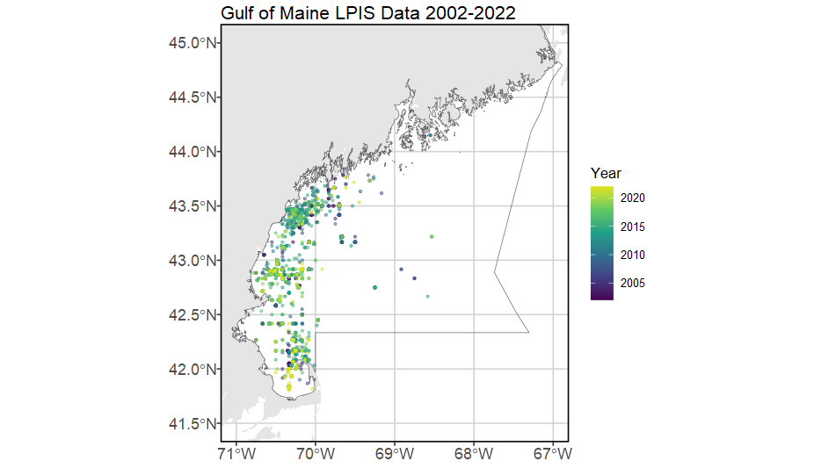
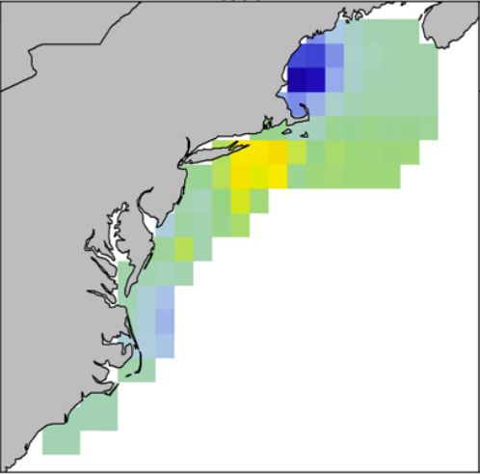
Model structuring – domains
1993 - 2020
2002 - 2022
Old
Updated
Notes:
Old – Includes all of Georges Bank, GoM (including Canadian-administered portion, which is weird because there is no data there), and south of Cape Hatteras. Domain has variable distance from shore to outward edge, seems to align with continental shelf break. Temporal domain 1993-2020.
New – Gulf of Maine only (area has 80% of coastwide US effort). Temporal domain 2002-2022. No samples east of 69deg. No samples from June or July 2020 (no observer coverage to make prey model for this period, and VAST cannot handle missing values in density covariates). Data from 2022 included, fitted, but not interpreted in results due to excessively poor fit.

Slide 7
Model structuring – data inputs
Data volume
Fishermen frequently name the bathymetric feature they fish on/near, and must state their vessel’s home state. Using these characteristics, I made assumptions about lat-lon coordinates of some fishing efforts that were previously missing spatial information.
Some guys gave LORAN coordinates originally! These were translated to lat-lon.
Number of fish caught = response
Do not have biomass information for every fish, must use abundance instead
Fishing hours (time spent explicitly fishing, not steaming) = effort
Do not have time spent at sea to match Canadian model, no way to estimate.
See section at end of this PPT for info how I converted Canadian time at sea to fishing hours in the joint model
Number of lines as catchability covariate for both linear predictors
Thinking that more lines in the water likely affects both likelihood of encountering fish AND the positive catch rate.
Have to remove like 12 samples that have missing # of lines data
Notes:
LORAN is cool and I had no idea it existed until earlier this year. Older fishermen and fishing families will reference their favorite grounds by LORAN coords because it was the standard marine navigation method from WWII until the late 90s, and still operable off the US coast until 2010. Translating between LORAN and GPS coordinates is possible, though it requires assumption/a priori knowledge of which two LORAN towers are being used to define a position. The system works by picking up a radio signal broadcast by each of the two towers, measuring the time delays between the signals, and plotting intersecting hyperbolas to determine position. In our spatial domain, the most likely used towers are in Nantucket, MA; Seneca, NY; Carolina Beach, NC; and Caribou, ME. LORAN systems were discontinued and disassembled in the early 2010s in favor of GPS.

Slide 8
Model structuring – spatio-temporal variation
No geometric anisotropy – fails to converge when turned on
Indicates equal rate of change across alongshore and offshore axes
Thinking this is caused by limited spatial extent covered by samples, curved nature of GOM coast, and/or highly migratory nature of the fish?
1st linear predictor (presence/absence)
Prey, SST, AMO, bathymetry used as density covariates
NAO dropped (no noticeable effect)
Temporal structure (random walk) of spatiotemporal variance, fixed effects for each year’s intercept
2nd linear predictor (positive catch)
No spatial or spatiotemporal variation (too few times where >1 fish caught)
Temporal variation is a random effect independent for every year

Slide 9
Gaussian Markov Random Fields (“fine_scale”)
GMRFs allow for spatial heterogeneity at a finer scale than the knot spacing in the model
Difficulty getting this to work, only converges if spatial and spatio-temporal variation are turned off for second linear predictor (positive catch rate)
Also only works when df>=5 in natural spline habitat formulas (more on this later)
Which means spatial and spatio-temporal variation in positive catch rate are driven by density covariates and temporal variation. There’s some residual variability from covariates we haven’t explicitly modeled that we can’t implicitly “soak up” anymore.

Slide 10
Density covariate updates
SST
Old: 1deg by 1deg spatial resolution, weekly timestep
New: ¼ deg spatial resolution, daily timestep
Depth
Old: MARMAP R package, 1 minute x 1 minute grid
New: GEBCO 15 arc-second interpolated grid
AMO
Old: Annual timestep
New: Monthly timestep
Prey
Old: Basin-wide annual herring SSB from stock assessments
New: Spatiotemporal density from VAST model using observer data inputs.
Notes:
The problem with AMO: it should have a greater effect but every year included in this model is a “positive phase” year. We have limited contrast to notice an effect. Strongest annual AMO signal for the entire time series is in 2022, weakest in 2002.

Slide 11
Density covariate model formula
Old model:
Additive model [response ~ s(explanatory1) + s(explanatory2) + …]
“Polynomial splines,” so probably b-splines?
Allowed R package splines2 to select optimum degrees of freedom
Updated model:
Still additive model
Natural splines. These allow for piecewise polynomial relationships across the bulk of the data but force linear relationships at the min/ max bounds. Reduces unrealistic relationships due to low sampling density at these bounds.
Set degrees of freedom to 5. Thus, four “internal” knots at 20, 40, 60, and 80% quantiles. Also has two “external” knots at min and max bounds.

Slide 12
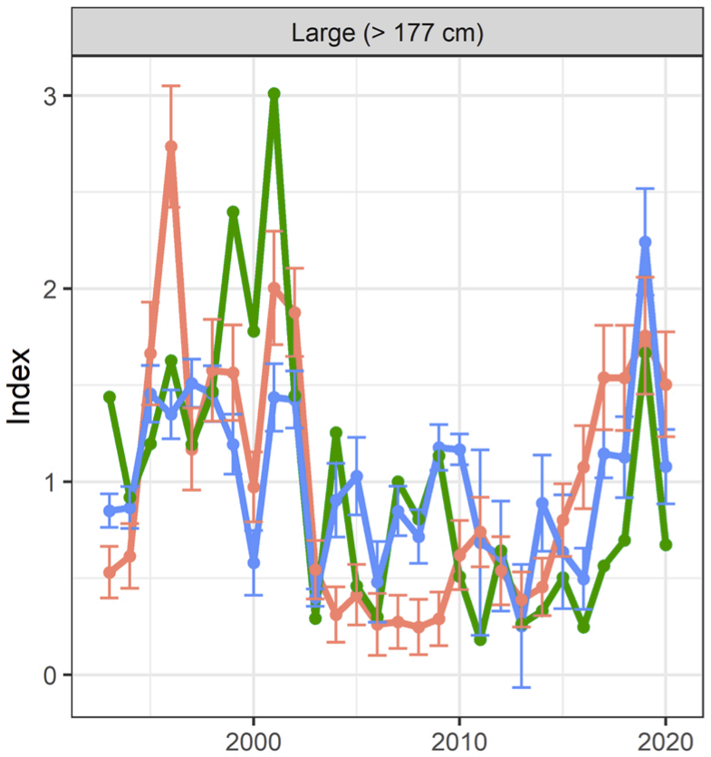
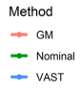
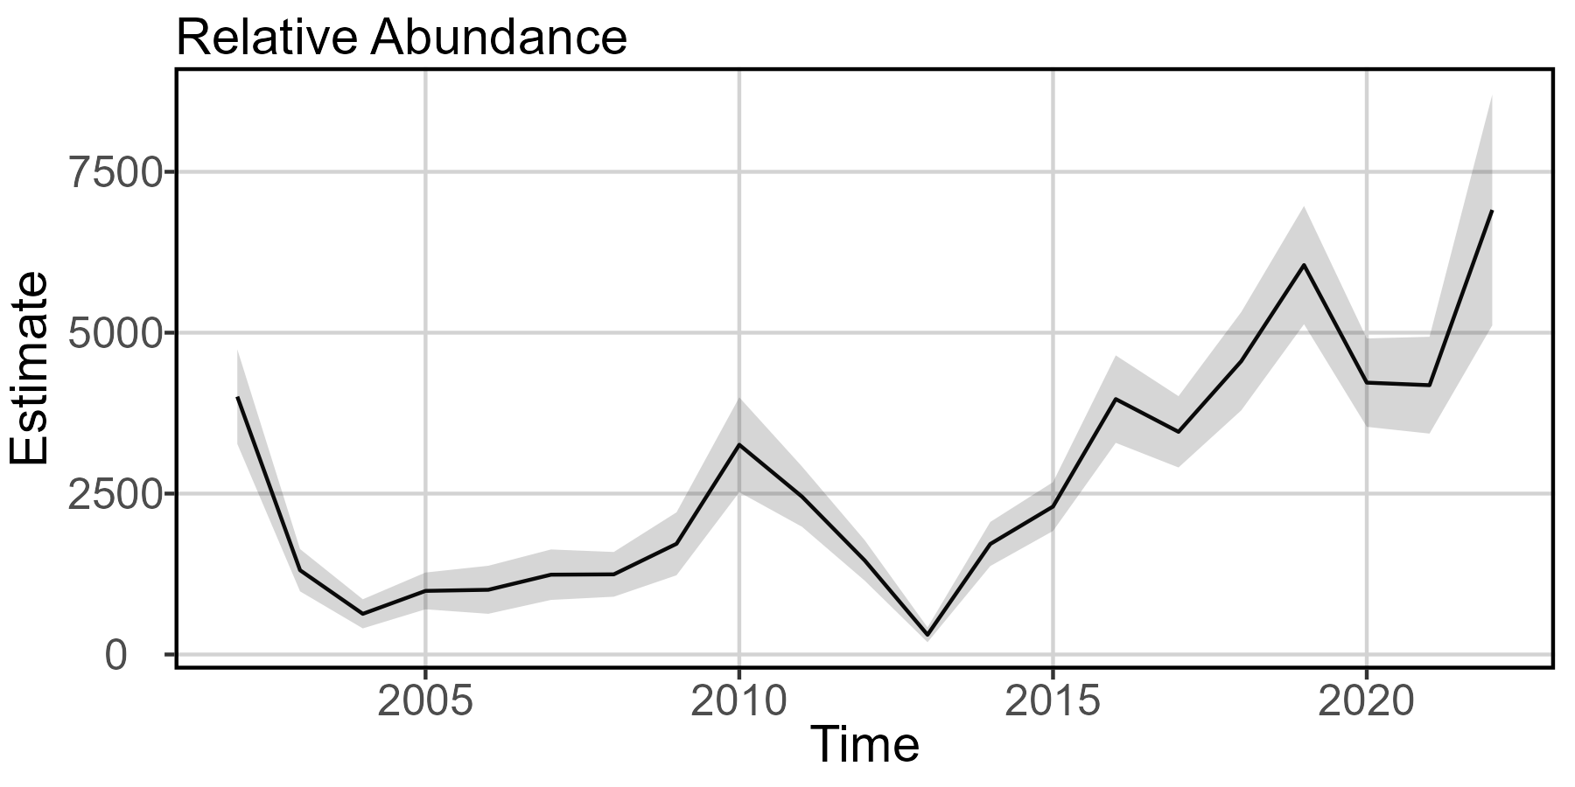
Indices of relative abundance
Old
Updated
Notes:
Old – Blue is VAST. Local minima at 2003 and 2013, local maxima at 2002, 2009, 2019. Model ends with dip at 2020.
New – local minima at 2004 and 2013, local maxima at 2002, 2010, 2019. Results at 2022 should not be interpreted.

Slide 13
Index of relative abundance takeaways
Model comparison
Old & new models indicate declines 2002-3/4, slow recovery through 2010
Old & new models show increasing population since 2013, hit local high abundance in 2019
Ecological meaning
Old & new models indicate time-series lows in 2013, which is likely driven by the “Wicked Tuna Effect” (show aired summer/fall 2012 and inspired new and inexperienced entrants to BFT fishery). Could also be lagging disturbance effect of massive marine heatwave in 2012.
Pretty wild that the trends match so well given the differing spatial extents. Really highlights how GOM is the driver of US BFT abundance.

Slide 14
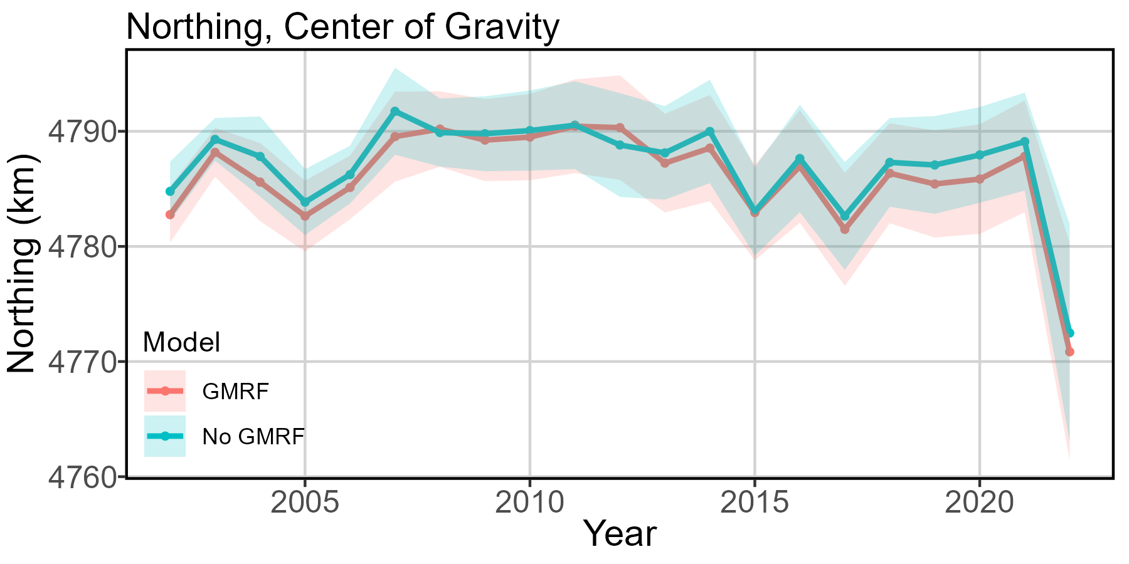
Overall explanatory power of covariates – GMRF
Notes:
Both models: spatial and spatio-temporal variation “turned off” for both linear predictors
Low confidence in results from 2022, recommend including data in model development but no interpretation of results in this year.

Slide 15
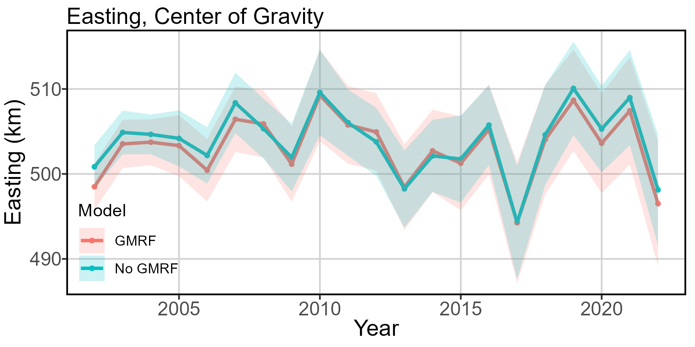
Overall explanatory power of covariates – GMRF
Notes:
Both models: spatial and spatio-temporal variation “turned off” for both linear predictors
Low confidence in results from 2022, recommend including data in model development but no interpretation of results in this year.

Slide 16
Explanatory power of covariates – GMRF takeaways
Model comparison
Old model: counterfactual analysis indicated included covariates accounted for majority of spatial distribution deviations
Updated model: Yeah, same.
Ecological meaning
Overall similarity between GMRF and non-GMRF models indicate we aren’t missing many influential spatio-temporal covariates which could otherwise be explicitly modeled as habitat covariates.

Slide 17
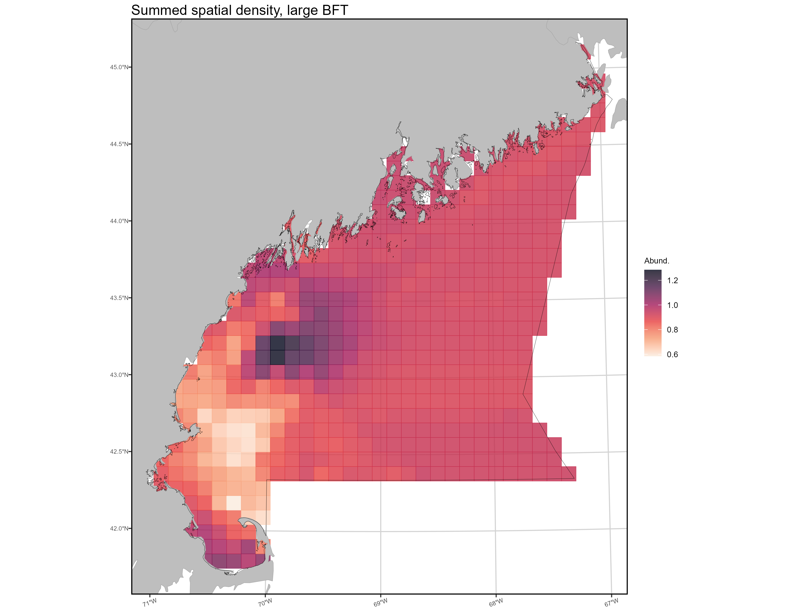
Mapping spatial density
Difficult to assess
abundance within
area east of 69°,
low confidence.
Persistent hot spot
Notes:
Temporal maps of density also provided to you in separate file. Is too small for detail on ppt slide.
This plot is SUMMED SPATIAL DENSITY. Or, the cumulative relative abundance of fish within each grid cell, summed over time.

Slide 18
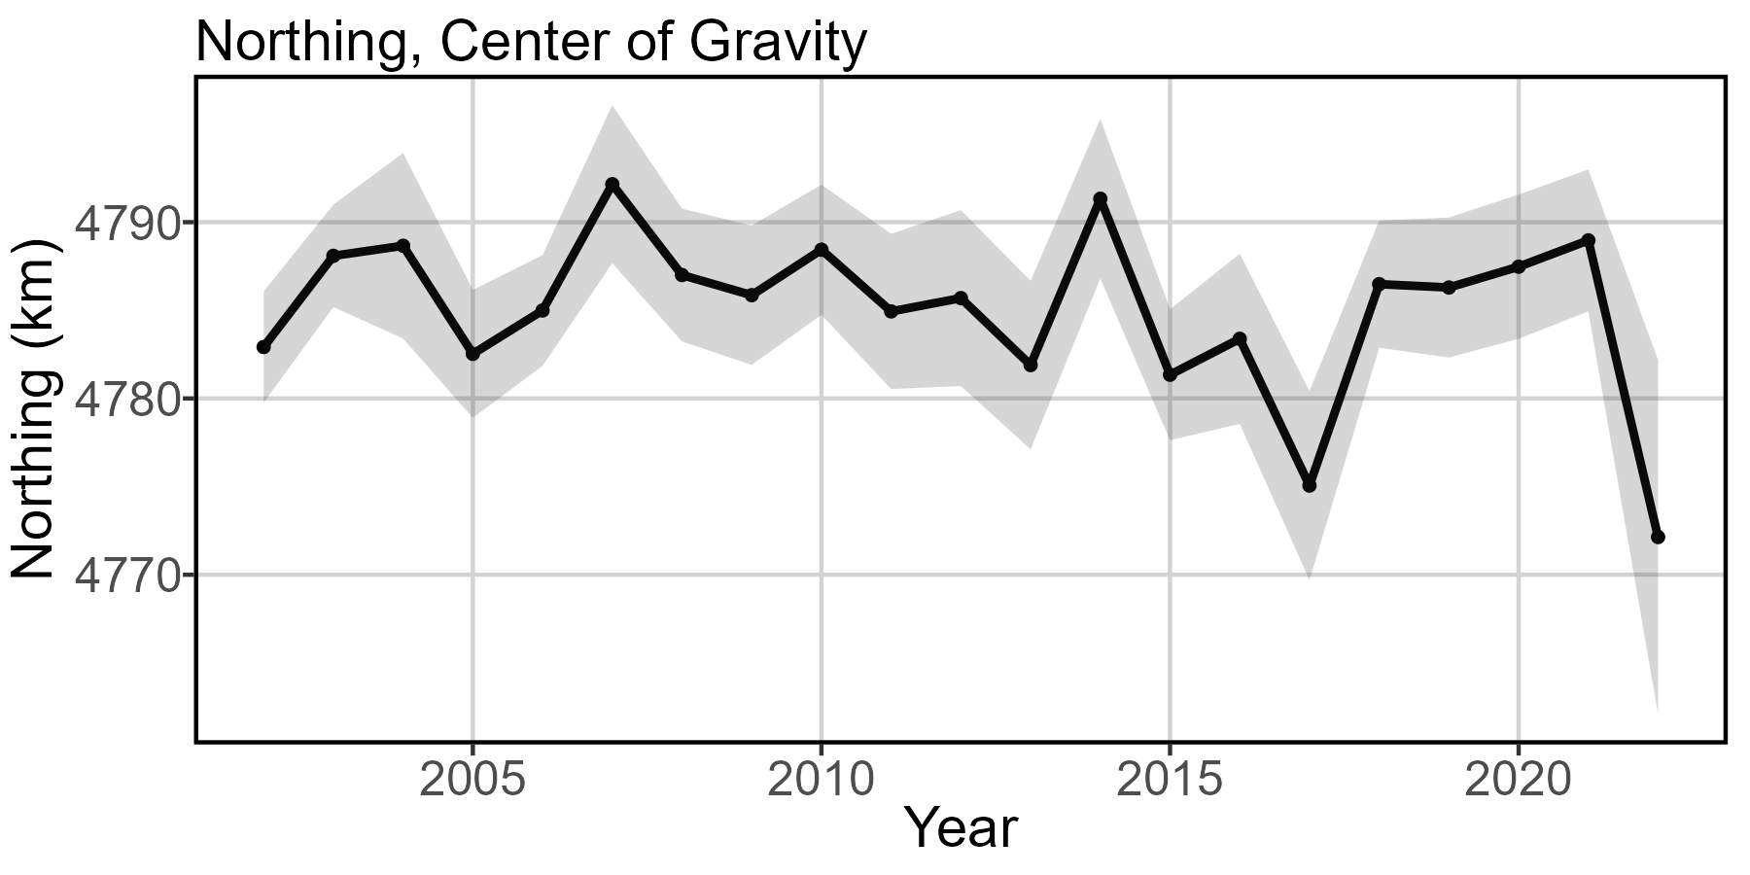
Center of gravity
Notes:
Model with GMRF, spatial and spatio-temporal effects turned on for linear predictor 1 (off for 2), temporal effects for both linear predictors, all chosen density covariates.
Low confidence in results from 2022, recommend including data in model development but no interpretation of results in this year.

Slide 19
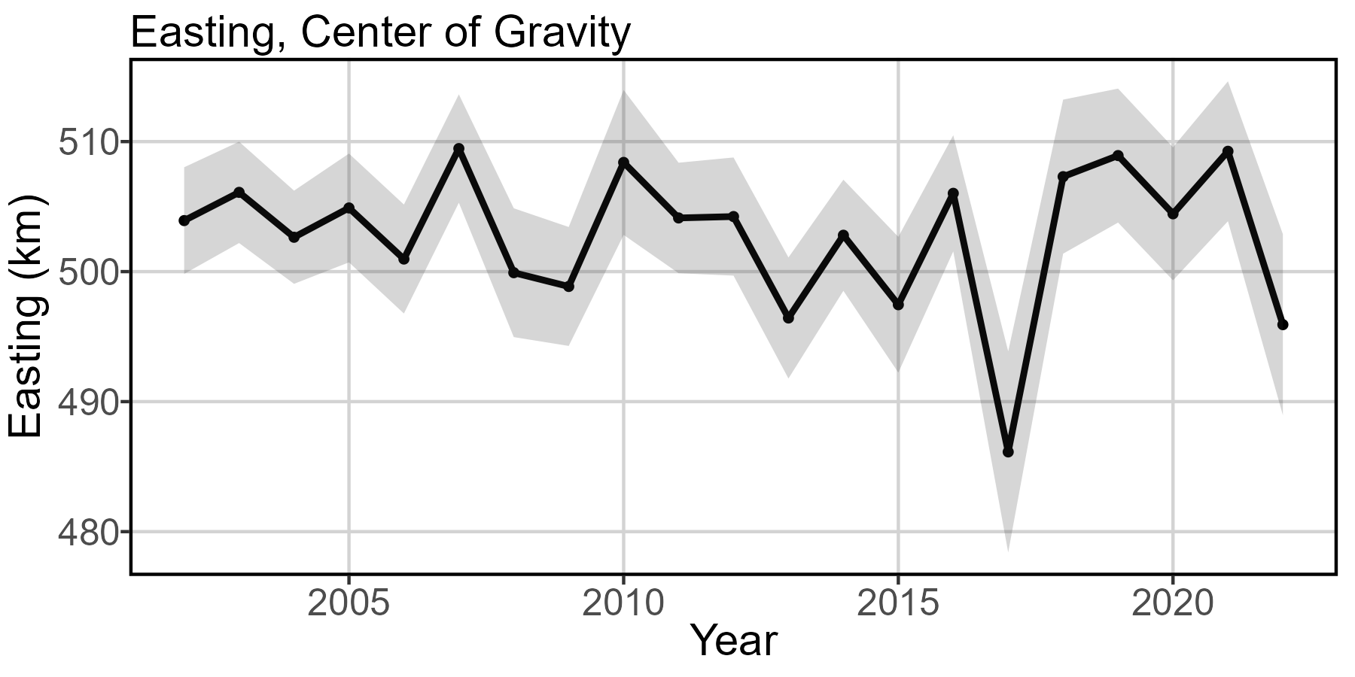
Center of gravity
Notes:
Model with GMRF, spatial and spatio-temporal effects turned on for linear predictor 1 (off for 2), temporal effects for both linear predictors, all chosen density covariates.
Low confidence in results from 2022, recommend including data in model development but no interpretation of results in this year.

Slide 20
Explanatory power of GMRF takeaways
Model comparison
Old model: 1km/ yr northward and 2km/ yr eastward shift, but uses entire US continental shelf, 1993-2020.
Updated GMRF model: 0.07 km/ yr SOUTH and 0.02 km/ yr WEST in Gulf of Maine, 2002-2021.
Ecological meaning
Fish, fishermen, or both are condensing into the near-coastal region of GOM between Gloucester and Portland.
This is not a random sampling scheme. People are going where they are comfortable, where steam times are short and small boats can operate, where they have been told there are fish, etc. Model results could reflect a shift in spatio-temporal effort distribution and intensity more than spatio-temporal changes in BFT productivity or distribution.

Slide 21
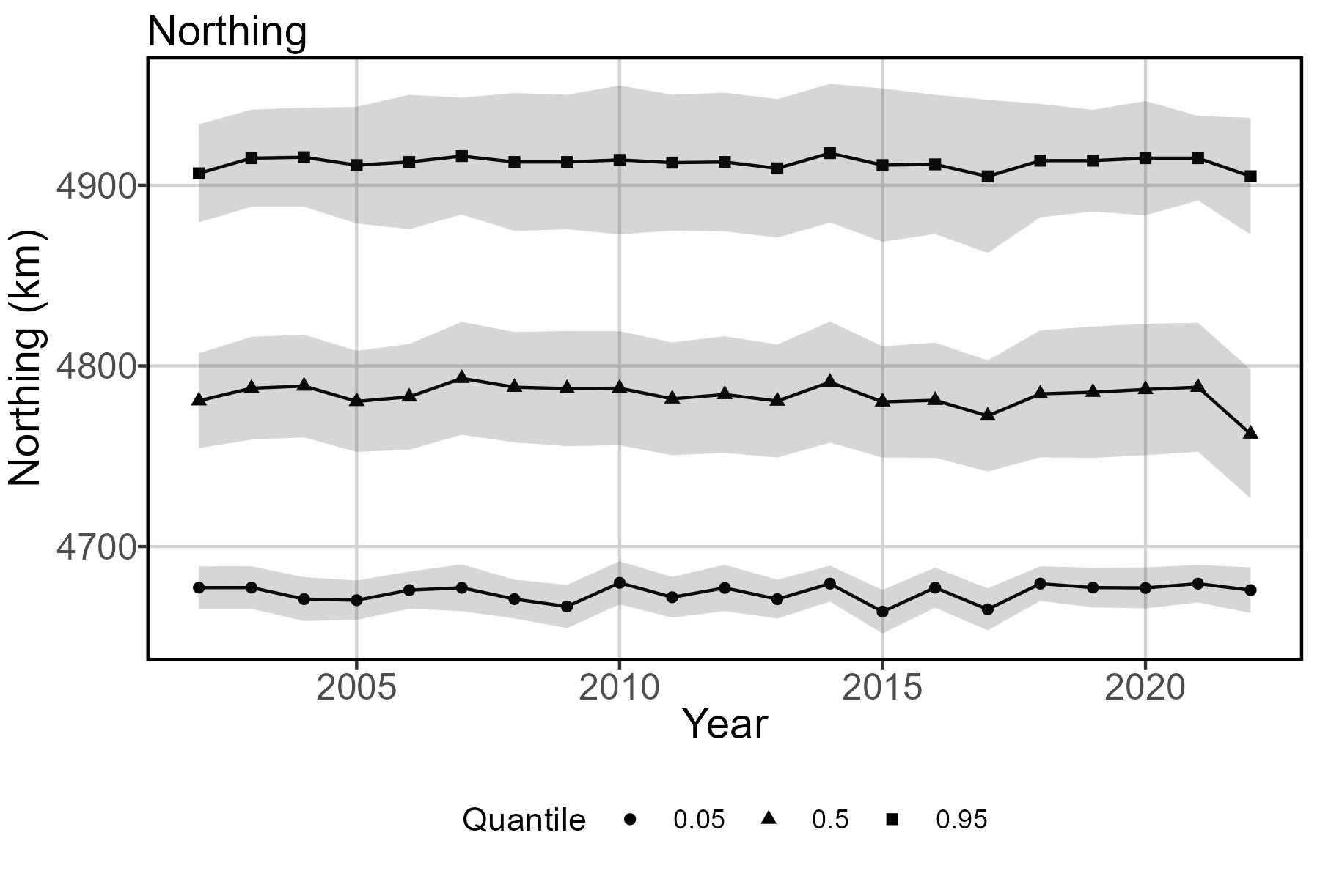
Range Edges
Notes:
Results from 2022 should not be interpreted.

Slide 22
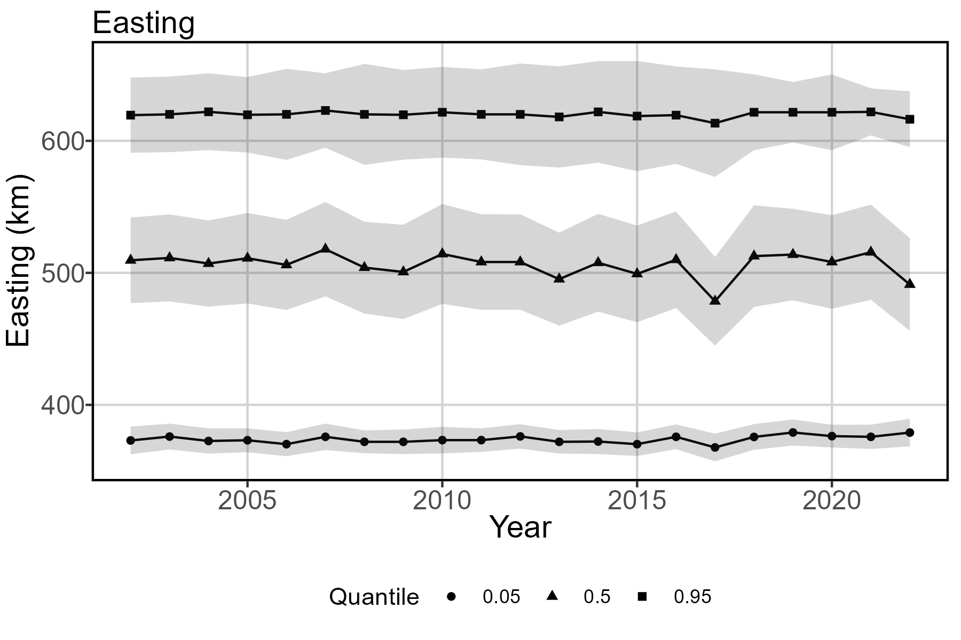
Range Edges
Notes:
Results from 2022 should not be interpreted.

Slide 23
Range edge takeaways
Range edges not addressed in previous models
Ecological meaning
Model with GMRF has less variance for low and high quantiles
0.05 quantile shifts north (~0.10 km/ yr) and east (~0.11 km/ yr).
0.5 quantile shifts SOUTH (~ 0.11 km/yr ) and WEST (~0.18 km/yr)
0.95 quantile is not super informative given artificial break conforming to international boundaries. Tons more tuna in SWNS and GSL not accounted for. But here, shows negligible change.
Overall: slight habitat loss at southwestern corner, while center of gravity and 0.5 quantile show shifts inshore and south.
Noticeable (though slight) northward habitat compression is concerning given southward shift in fishing effort over time. See appendix for maps of US fishing effort spatio-temporal shifts.

Slide 24
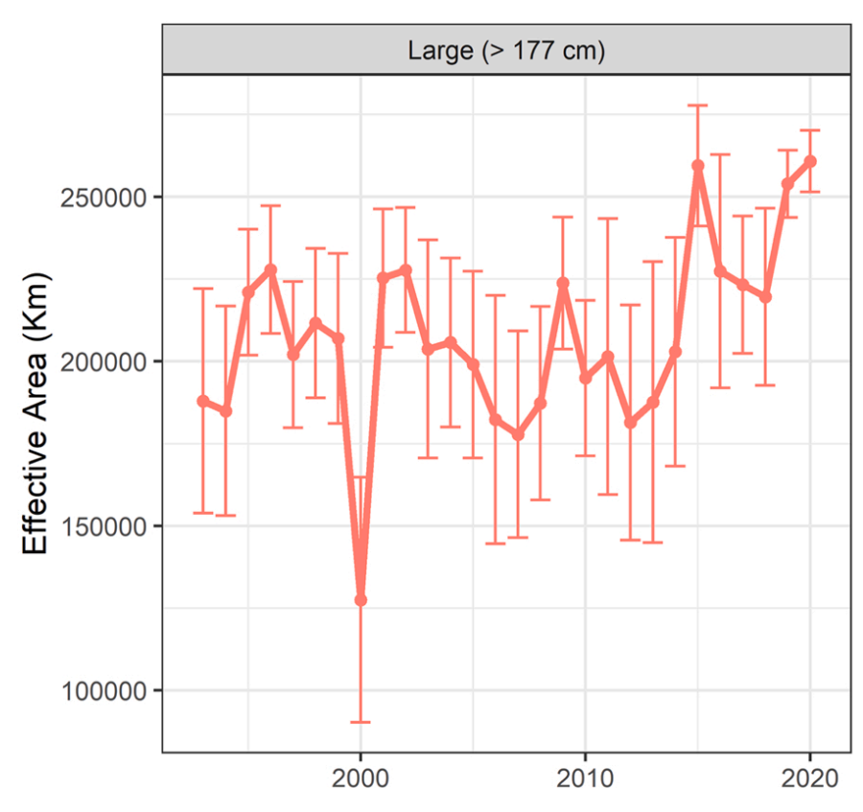
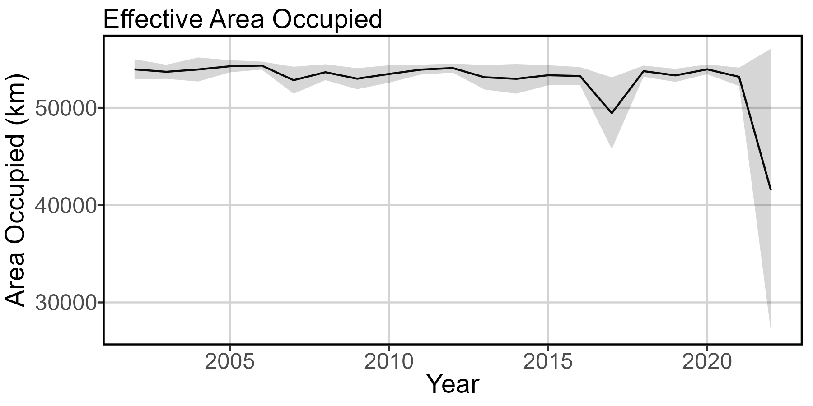
Effective area occupied
Old
Updated
Notes:
Old model: local minima at 2007, 2012, 2018. Local maxima at 2002, 2009, 2015, 2020. Uses entire NEUS continental shelf.
New model: Results from 2022 should not be interpreted. Relatively consistent, which makes sense since the spatial domain is only Gulf of Maine. Only noticeable feature is dip at 2017.

Slide 25
Effective area occupied takeaways
Model comparison
This one is apples to oranges for sure because of differing spatial extents
Not sure where the increase in area occupied is coming from in the old model. COG moves northeast, but unlikely that BFT are entering new habitat at northward edge of model spatial domain.
Ecological meaning
Small annual decrease in area occupied (average loss 59 sqkm/ yr)
Makes sense given northward creep of southern range end
Dip in 2017: probably driven by unusually high and unsuccessful effort at Fippennies Ledge, artificially shrinks range inshore. Also notable: SST anomalously cold within the time series.

Slide 26
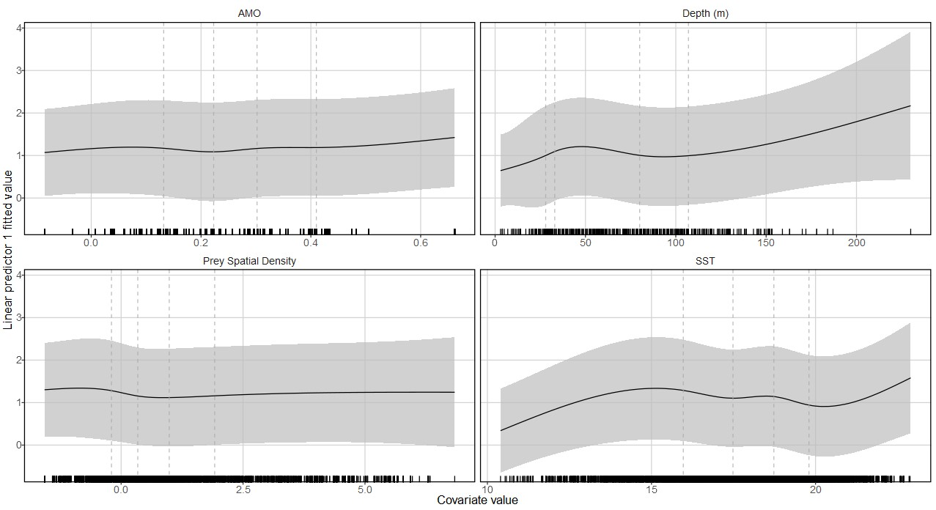
Density Covariate Marginal Effects
Notes:
Dashed vertical lines are where internal knots are placed (0.2, 0.4, 0.6, 0.8 quantiles).
A problem: 2022 data included in this result. Cannot really be parsed out.

Slide 27
Density covariate marginal effects takeaways
Marginal effects not assessed in previous model (new feature)
Ecological meaning
All marginal effects shown are for first linear predictor (presence/absence)
Increasing AMO strength increases presence likelihood, near-linear
Depth relationship hard to assess given strong nearshore feature preference of fishermen. Unsure if presence increases with depth to this degree after ~105m.
Very limited effect of prey density. Likely that the prey model “soaks up” spatio-temporal effect of SST on prey, though pre-modeling checks don’t show correlation. Probably not much new in this density covariate.
Unsurprisingly, low and high SST translate to absence of BFT. Exponential increase in presence between 80% quantile and max SST probably not realistic. Local maxima at about 16°C.
Notes:
Higher likelihood of presence at low prey density: are they biting because they’re hungry?

Slide 28
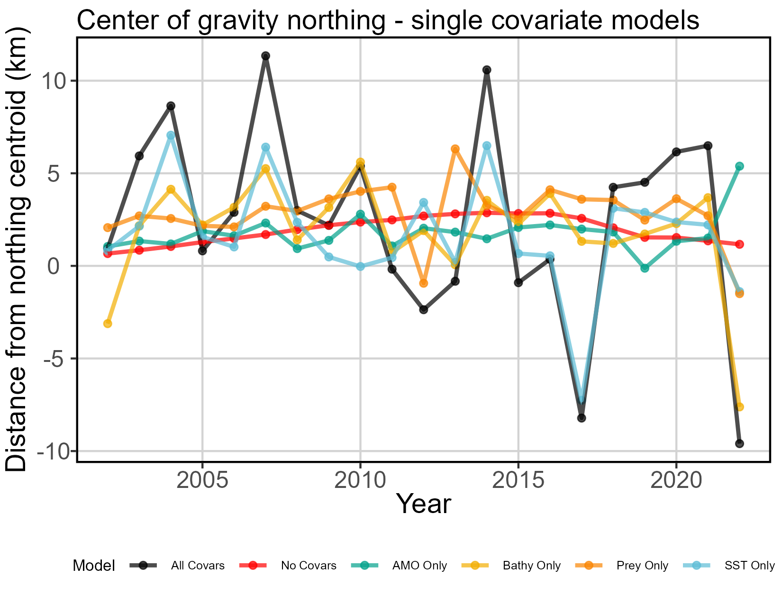
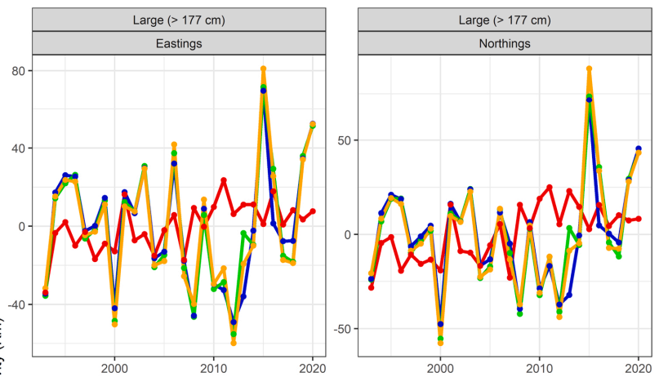
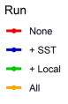
Relative explanatory power of density covariates
Notes:
All models have spatial and spatio-temporal effects turned off for second linear predictor

Slide 29
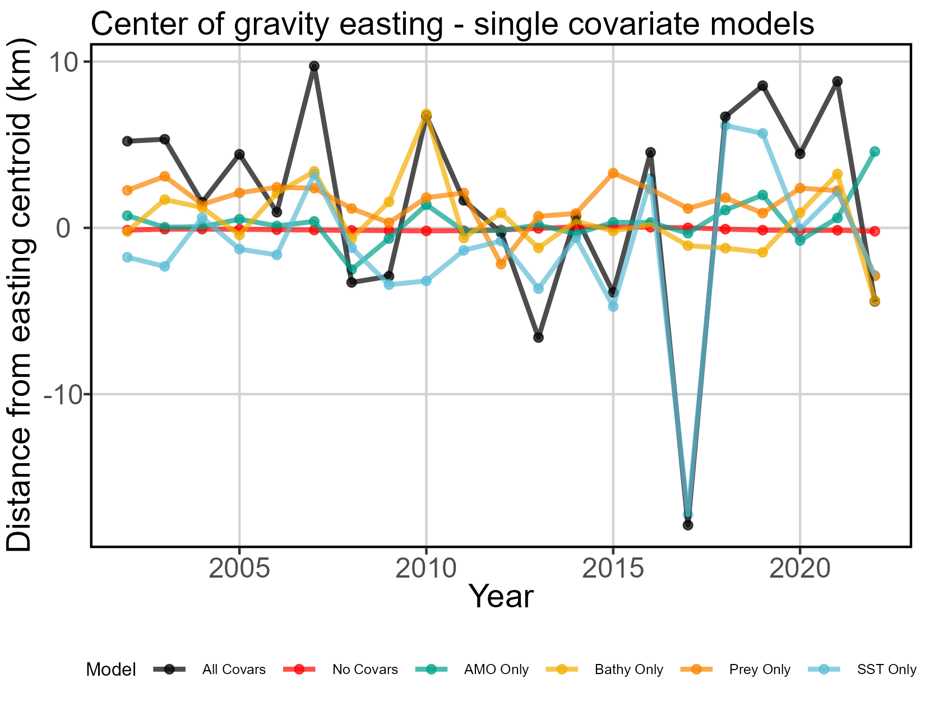
Relative explanatory power of density covariates
Notes:
All models have spatial and spatio-temporal effects turned off for second linear predictor

Slide 30
Relative explanatory power of covariates takeaways
Model comparison
Previous models found center of gravity shifts driven mostly by SST, that carries through to this model
Both old and new “no covariates” models indicate northward shifts from 2002-2015, new model indicates southward swing 2016-2021. This is a little less obvious in the old model but may be happening there, covered by a lot of noise.
Ecological meaning
AMO has little explanatory power for center of gravity shifts
Bathymetry and Prey as single covariates produce similar COG trends (except 2011-2013) and contribute little explanatory power
Bathymetry is temporally static, but the depth preference of fishermen (and perhaps the fish themselves) is not.
Notes:
Again, consider the problem with AMO: 2002-2022 are all positive phase years of varying strength. We have no negative phase years as a comparison.

Slide 31
Overall
Comparison
Old and new models too different to compare
Abundance
That being said, old and new models both estimate a rapid drop in abundance 2010-2013, recovery since 2013
Center of gravity
Noticeable northward shift 2002-2015, slow return to early 2000s center of gravity area since 2015.
Average annual center of gravity change is slight southwestward shift
Range shifts
Range edges and effective area occupied show slight habitat compression at southern edge of GOM.
Density covariates
Major driver is SST. Non-linear relationship bt encounter rate and SST, with local peak encounter rate at around 15C. Low confidence in noted positive relationship bt encounter and increased SST past 20C.
Obvious increase in SST through study spatiotemporal domain (avg 0.08 deg/yr). Also obvious increase in abundance through same temporal domain. Are BFT more adaptable to warmer water than we expect? Do we see decreased body size in this time (smaller fish better able to respire in warmer waters)?

Slide 32
Tweaks
Consider estimating prey spatiotemporal density in June and July 2020 (no data) from rest of 2020 data and June-July trends of previous years?
Would allow for BFT data in these months to be reintroduced to model.
Drop 2022 from modeling efforts?
Previously, doing this caused models to fail. But the results are so poorly fitted and cannot be interpreted if kept in. Kind of on the fence about what to do here.
Ask for 2023 data?
No idea about how this will affect results. Kind of scared it will blow everything up. But there’s a chance it will “fix” 2022 problem. Don’t know when LPIS will release the data, or if it’s even been pulled together yet. 2022 data was released May 2023.
Turn on bias correction and re-run
This is the last step. Once we’re happy with everything else, we do this.
Notes:
LPS Data Catalog: https://www.st.nmfs.noaa.gov/st1/recreational/LPS_Data/
Do we still want to do small tuna? I have the data ready to go and can reformat these models for small guys too.

Slide 33
Model choice and input comparisons Updated US-Canadian joint models, large size - Hansell et al. (2021) Development of a western large Atlantic BFT index of abundance based on Canadian and US rod and reel fisheries data

Slide 34
Model structuring – domains
Temporal domain: 2002-2022
Same as US only model. Previous model used 1996-2019, which is all overlapping data. We exclude data prior to 2002 due to lack of reported unsuccessful trips (no catch)
Spatial domain: US-Canadian continental shelf waters.
Plus 10km buffer to offshore edge of continental shelf, trying to keep in fishing trips made in canyons on the edge.
Southern tip at mouth of Chesapeake (NAFO Unit 6B), northern tip at intersection of Nova Scotian coastline and 60°W (NAFO Unit 4W).
Encompasses all data, no areas are dropped.

Slide 35
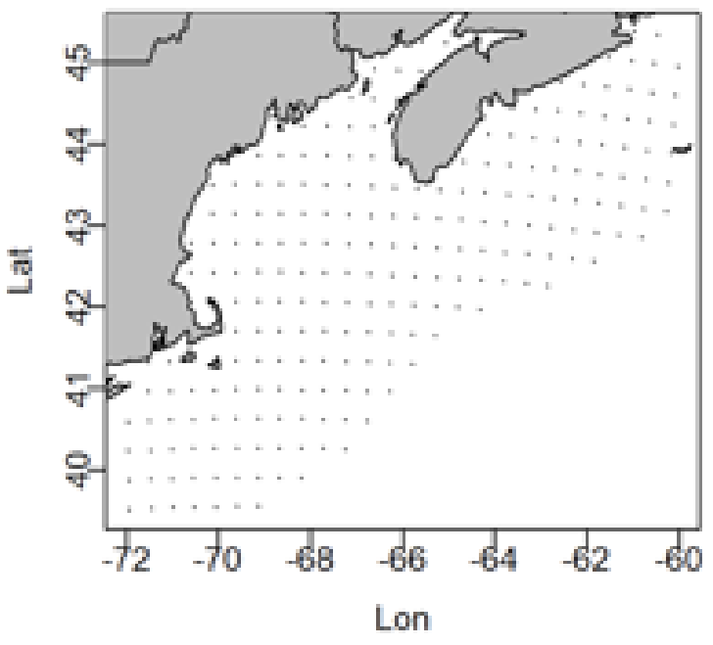
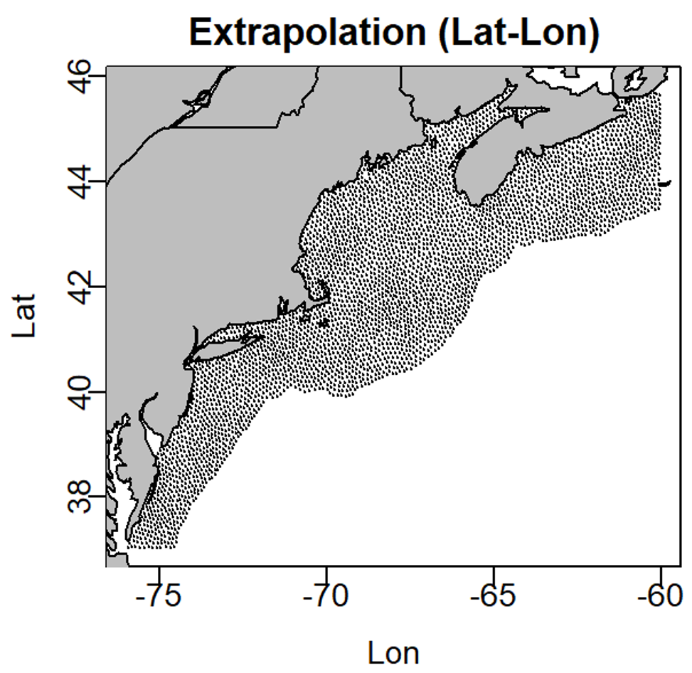
Model structuring – domains
1996 - 2019
2002 - 2022
1993 - 2020
Old
Updated
Notes:
Old – did not provide original code describing methods for selecting spatial domain. But states domain runs from Massachusetts to Nova Scotia. Looks like it is bound to continental shelf waters but it’s hard to tell with this spatial domain and resolution. Temporal domain 1996 – 2019.
New – Chesapeake Bay mouth to Nova Scotian coastline intersection with NAFO unit area 4W. Shore to continental shelf edge plus 10km buffer. Temporal domain 2002-2022. Spatial resolution much higher– 400 knots with 4000 extrapolation points.

Slide 36
Model structuring – data inputs
Sheer data volume
Old model excludes trips longer than 24 hours duration. Removes trips later than October 31, trips without spatial information.
New model only excludes trips longer than 7 days (stakeholder recommendation), keeps trips until Dec 15 (stakeholder recommendation), has a fix for missing spatial information. It’s a huge boost in Canadian data volume.
Number of fish caught = response
Do not have biomass information for every fish (US limitation), must use abundance instead
Fishing hours (time spent explicitly fishing, not steaming) = effort
See section at end of this PPT for info how I converted Canadian time at sea to fishing hours in the joint model
Old model uses time at sea (including steaming) as effort
Country-gear combination as vessel effect
Thinking that catchability is likely grouped by flag and gear, with random variation within the groupings.
Can’t use # of lines as a catchability covariate because Canadian harpoon fishery is included in this model– does not use lines.

Slide 37
Model structuring – spatio-temporal variation
Geometric anisotropy used
Indicates directionally-variant rate of change
Greater degree of similarity along NW-SE axis than any other direction.
Least degree of similarity along SW-NE axis.
1st linear predictor (presence/absence)
SST, AMO, bathymetry used as density covariates. No prey.
NAO dropped (no noticeable effect)
Temporal structure (random walk) of spatiotemporal variance, fixed effects for each year’s intercept
2nd linear predictor (positive catch)
Same as 1st linear predictor

Slide 38
Gaussian Markov Random Fields (“fine_scale”)
GMRFs allow for spatial heterogeneity at a finer scale than the knot spacing in the model
This actually worked with no problems for this model, thanks to increased data volume and a wider gradient of catch values (Canadian commercial fishery doesn’t only catch one fish and go home like US rec fishery)

Slide 39
Density covariate updates
SST
Old: no data source provided, assume same as US model
New: ¼ deg spatial resolution, daily timestep
Depth
Old: no data source provided, but dropped from final model
New: GEBCO 15 arc-second interpolated grid
AMO
Old: not included
New: Monthly timestep
Prey
Never got Canadian prey data, could not make a model for inclusion here.
Notes:
The problem with AMO: it should have a greater effect but every year included in this model is a “positive phase” year. We have limited contrast to notice an effect. Strongest annual AMO signal for the entire time series is in 2022, weakest in 2002. At least with Canadian fishing extending into December we have a slightly greater range of values.

Slide 40
Density covariate model formula
Old model:
Absolutely no information provided on structuring of density or catchability covariate formulas
Updated model:
Additive model
Natural splines
Set degrees of freedom to 3. Thus, two “internal” knots at 33% and 66% quantiles. Also has two “external” knots at min and max bounds.
Notice that this is a simpler model than the 5 knots required to make the US only model work

Slide 41
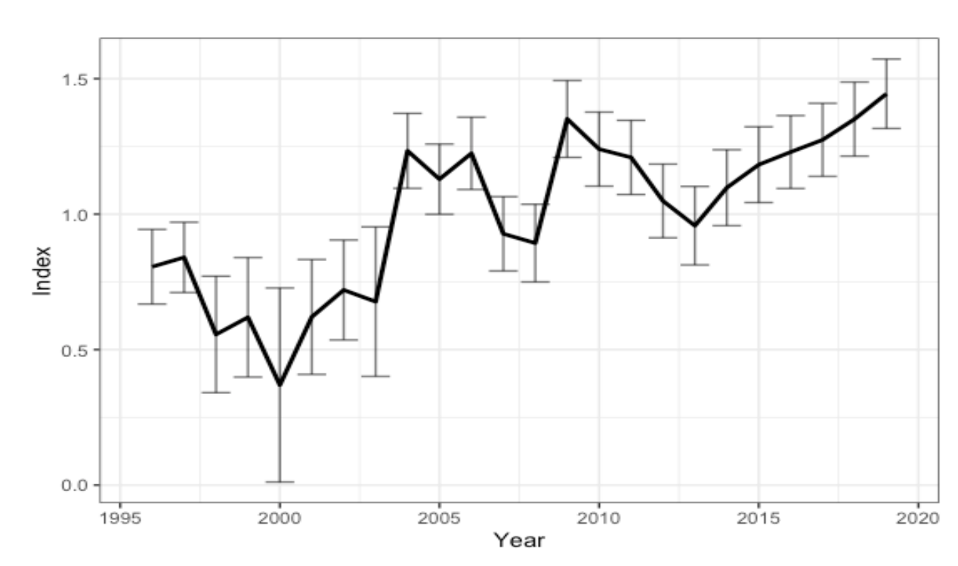
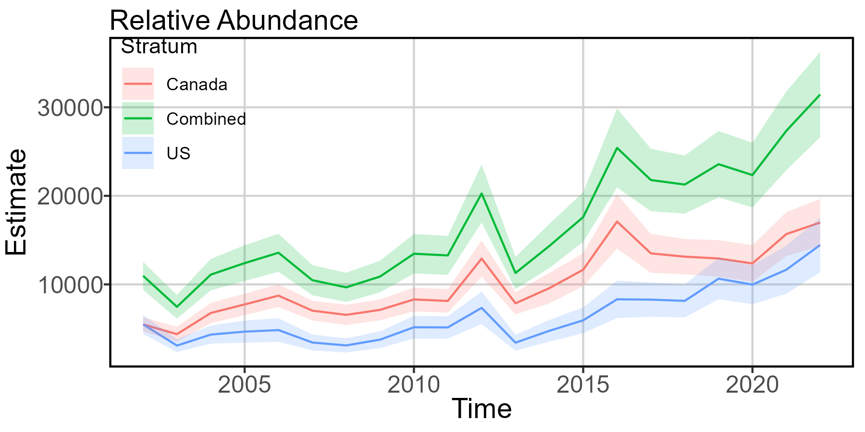
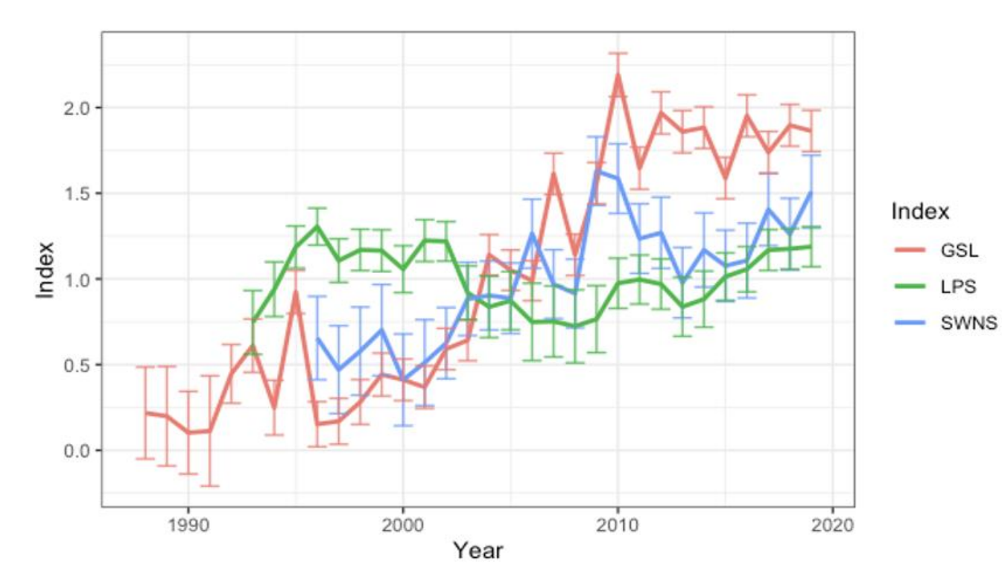
Indices of abundance
New
Joint VAST (Hansell 2021)
Standardized (Hansell 2021)

Slide 42
Index of relative abundance takeaways
Model comparison
Similar trends. Quick drop in rel abundance for all strata in 2013. General increase in rel abundance since 2014.
Ecological meaning
US relative abundance higher than SWNS rel abundance only in 2002 (during model spatial domain, 2002-2022). This could be related to AMO strength, as we shifted from cold to warm phase in the late 90s and it took a few years for the effect to get “up to strength.” Wouldn’t put too much stock in actual numbers, US LPS data much less compelling than Canadian commercial data.
Since 2014, US index of relative abundance has grown at a steadier rate than more variable SWNS index.

Slide 43
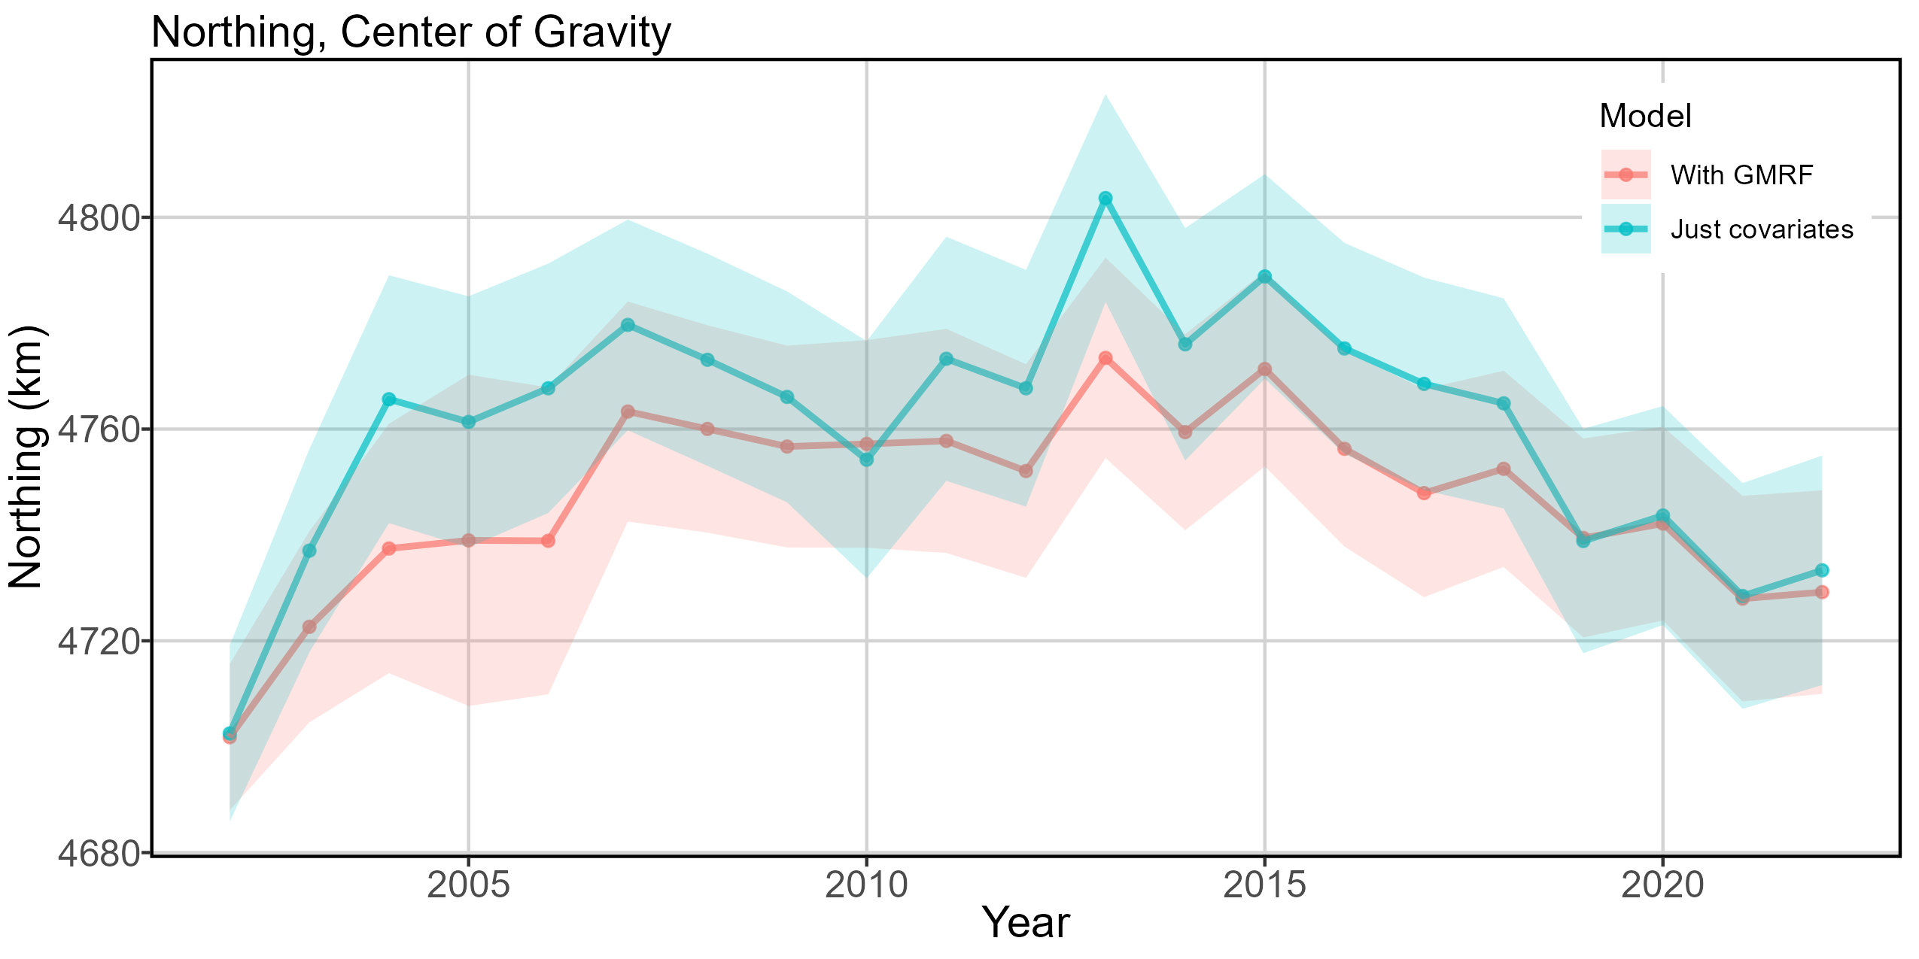
Overall explanatory power of covariates – GMRF

Slide 44
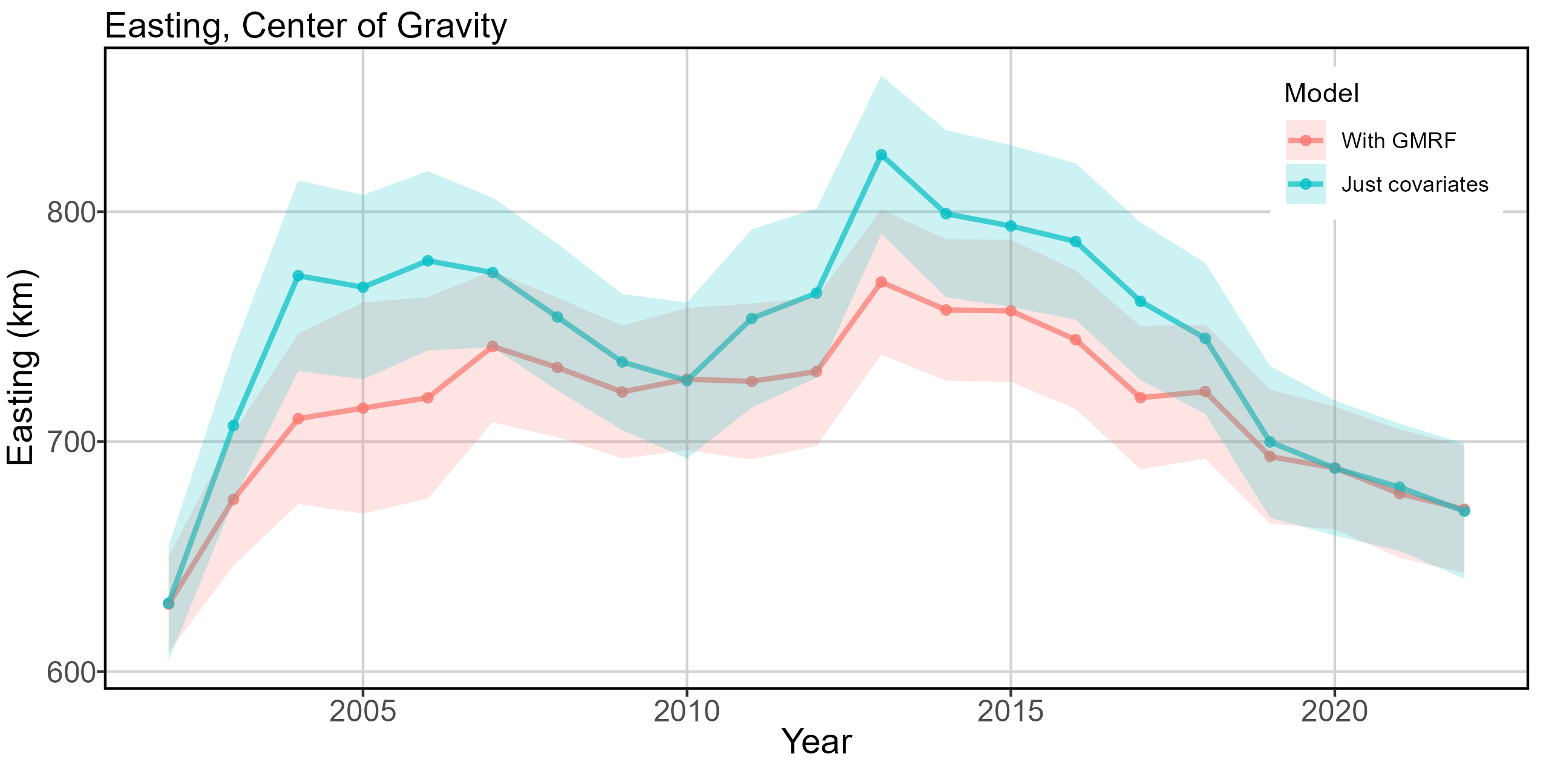
Overall explanatory power of covariates – GMRF

Slide 45
Explanatory power of covariates – GMRF takeaways
Not discussed in previous joint modeling efforts
Ecological meaning
Most similar years 2002, 2010, 2019-2022. These are local maxima along the time series of index of abundance. When abundance is lower, covariates alone don’t do as good of a job explaining center of gravity.
In other years, center of gravity of model without GMRF is much further to the northeast than the model with GMRF.
We are not explicitly modeling one or more habitat covariates that have a greater effect on tuna spatial density when regional abundance is low.

Slide 46
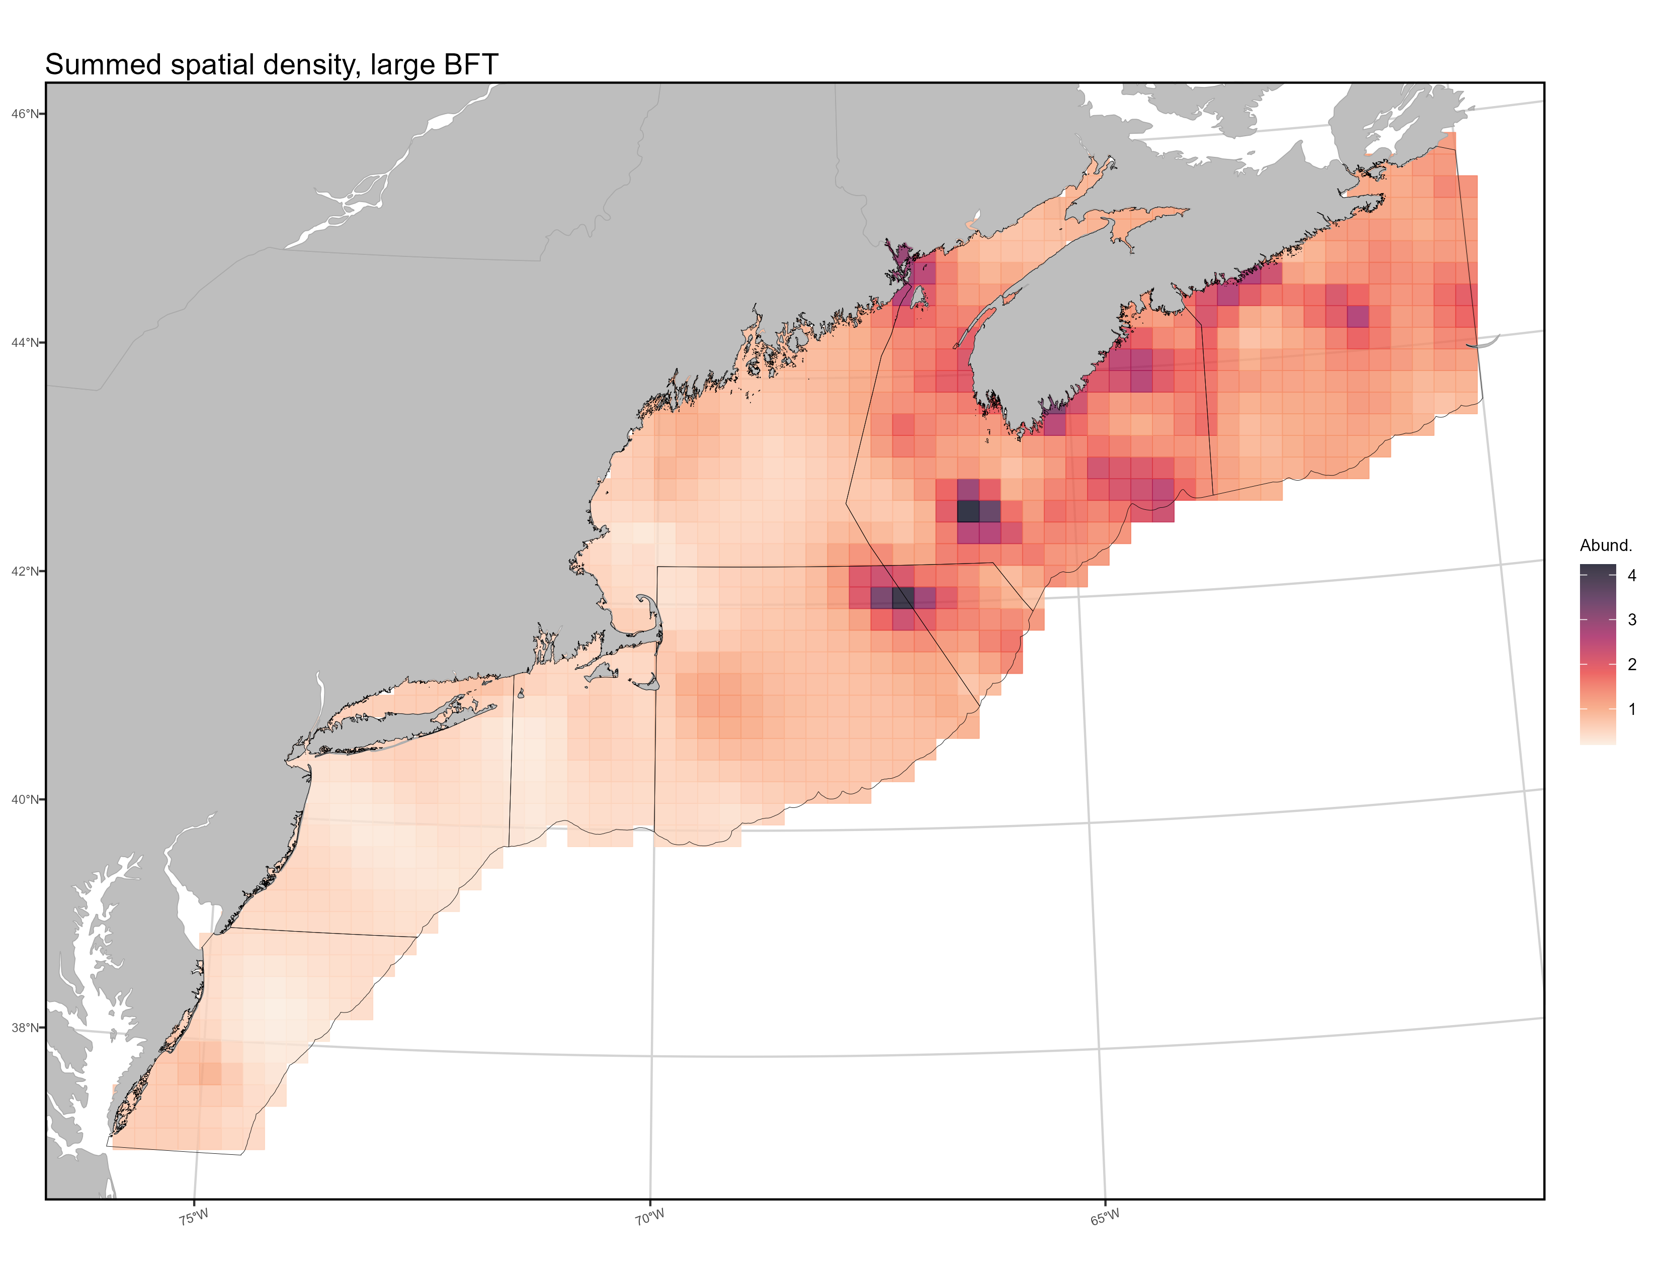
Mapping spatial density
Temporal shift in
hot spot from
Brown Bank to
Georges Bank
Persistent cold region
Notes:
Temporal maps of density also provided to you in separate file. Is too small for detail on ppt slide.
This plot is SUMMED SPATIAL DENSITY. Or, the cumulative relative abundance of fish within each grid cell, summed over time.

Slide 47
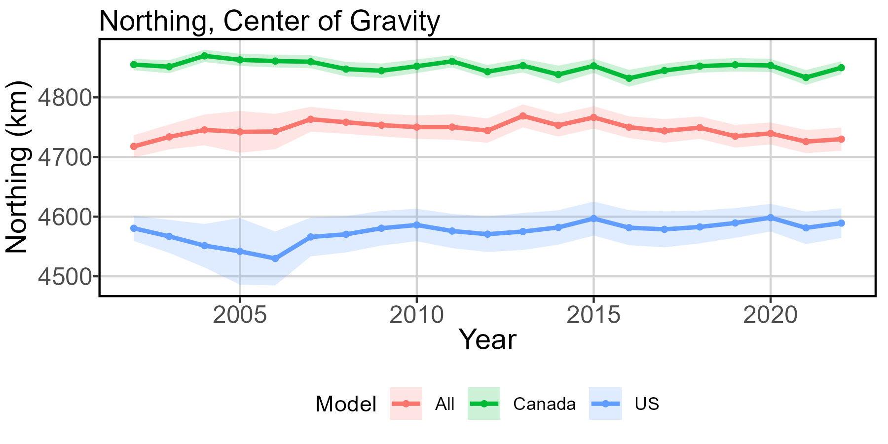
Center of gravity - strata

Slide 48
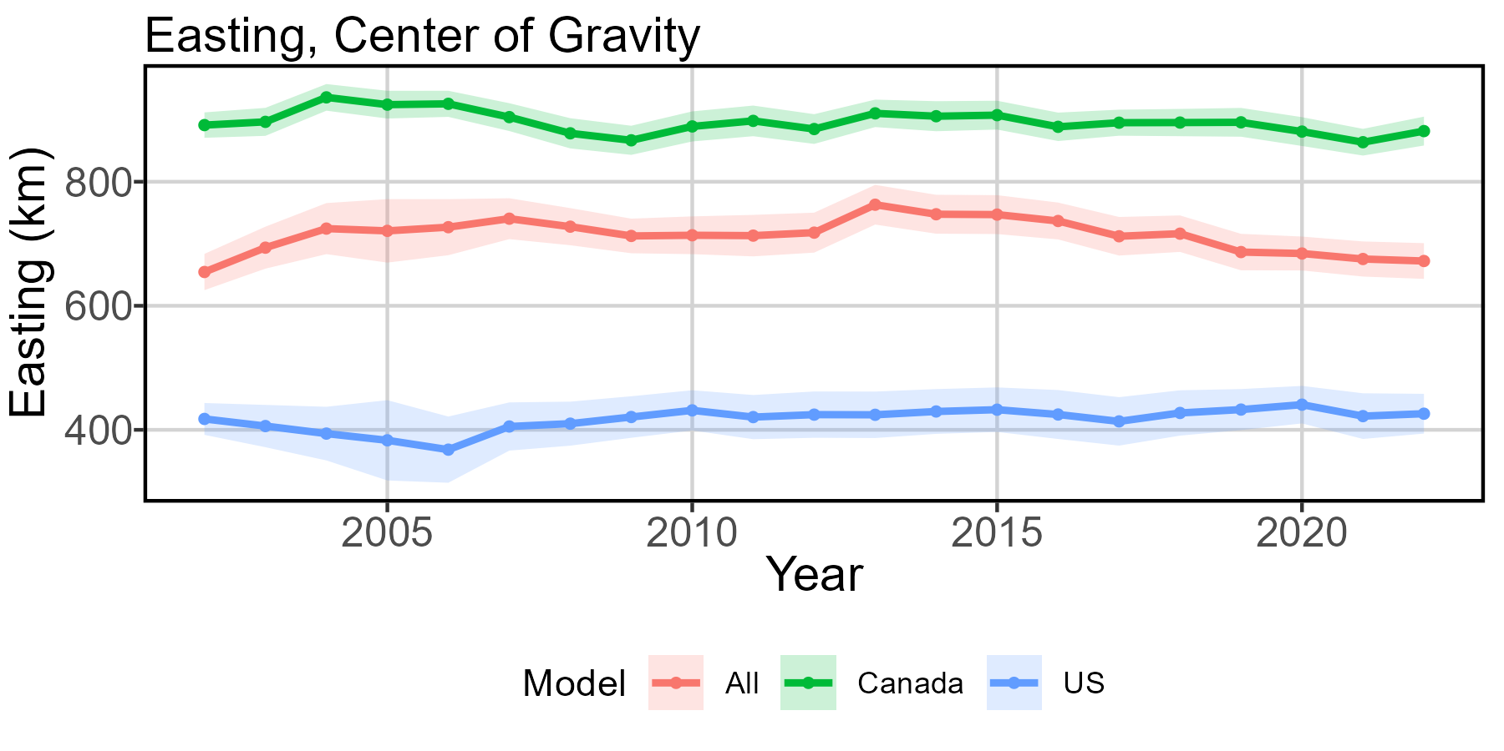
Center of gravity - strata

Slide 49
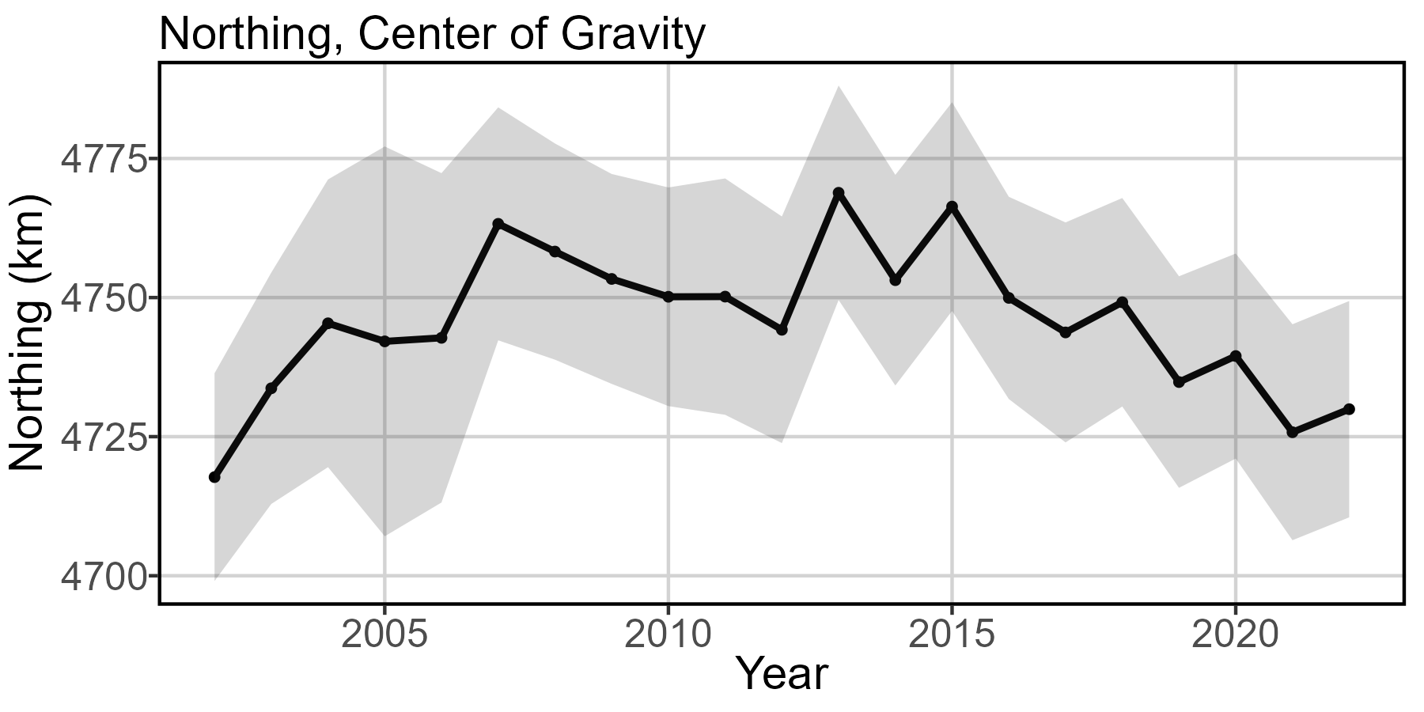
Center of gravity

Slide 50
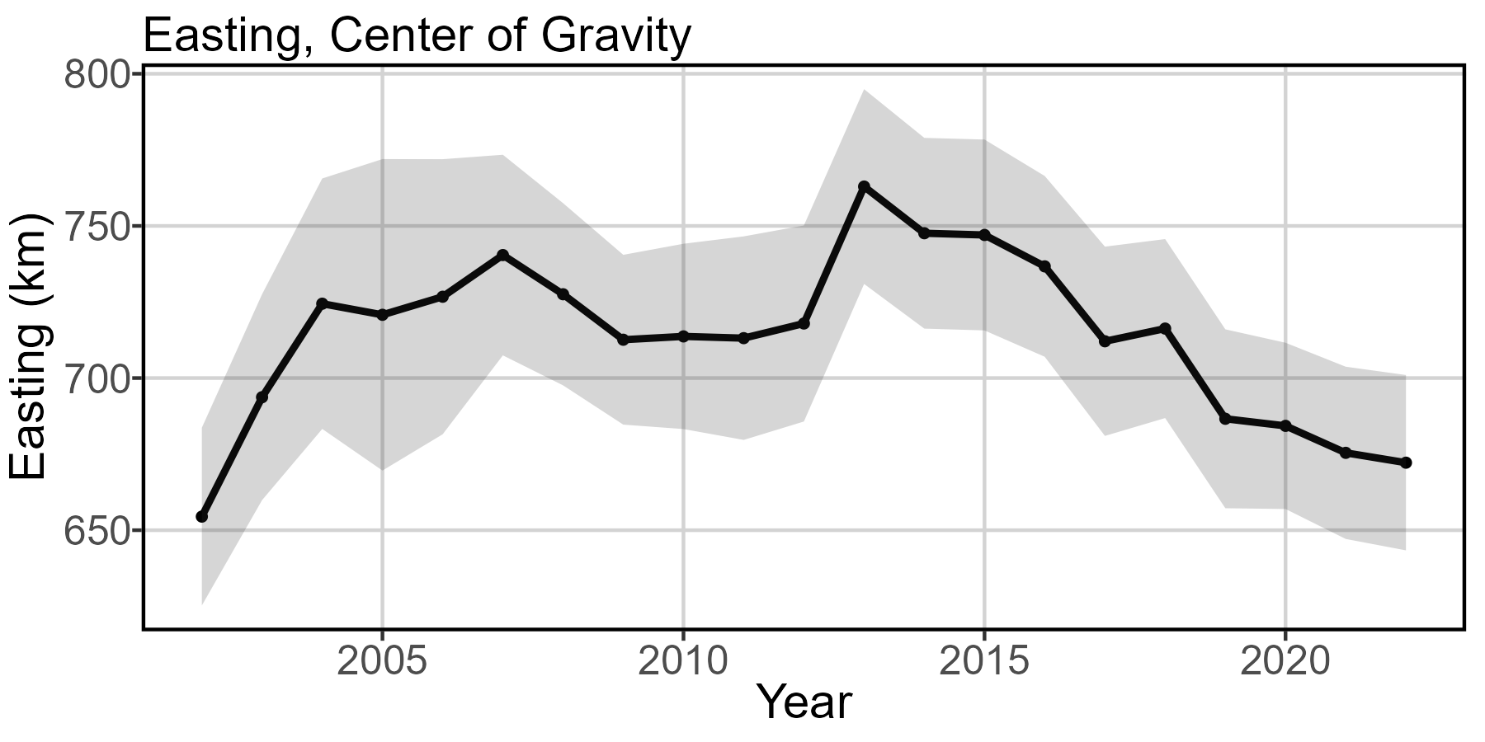
Center of gravity

Slide 51
Center of gravity takeaways
Model comparison
Old model: did not discuss center of gravity
Updated model: 0.1 km/ yr SOUTH and 0.6 km/ yr WEST overall, 1.8 km/ yr north and 1.9 km/ yr east for US strata, 0.8 km/ yr SOUTH and 1.4 km/ yr WEST for Canadian strata.
Ecological meaning
From the joint (combined strata) model, looks like a few distinct eras here: move northeast from 2002-2009ish, stagnation 2010-2012, rapid jump northeast in 2013, move southwest 2014-present.
Historically, NS coast and shallows around the Northeast Channel (Georges and Brown Banks) have been the most productive areas. The southwestward shift of COG since 2014 is driven by increased estimated abundance on the Georges Side.

Slide 52
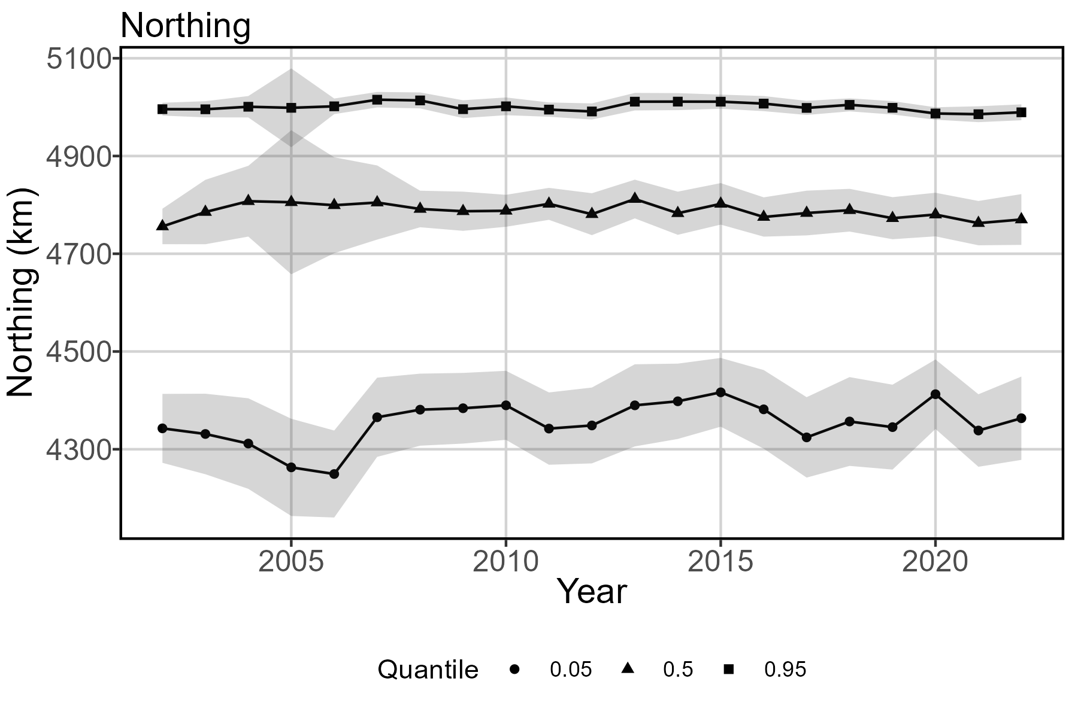
Range Edges

Slide 53
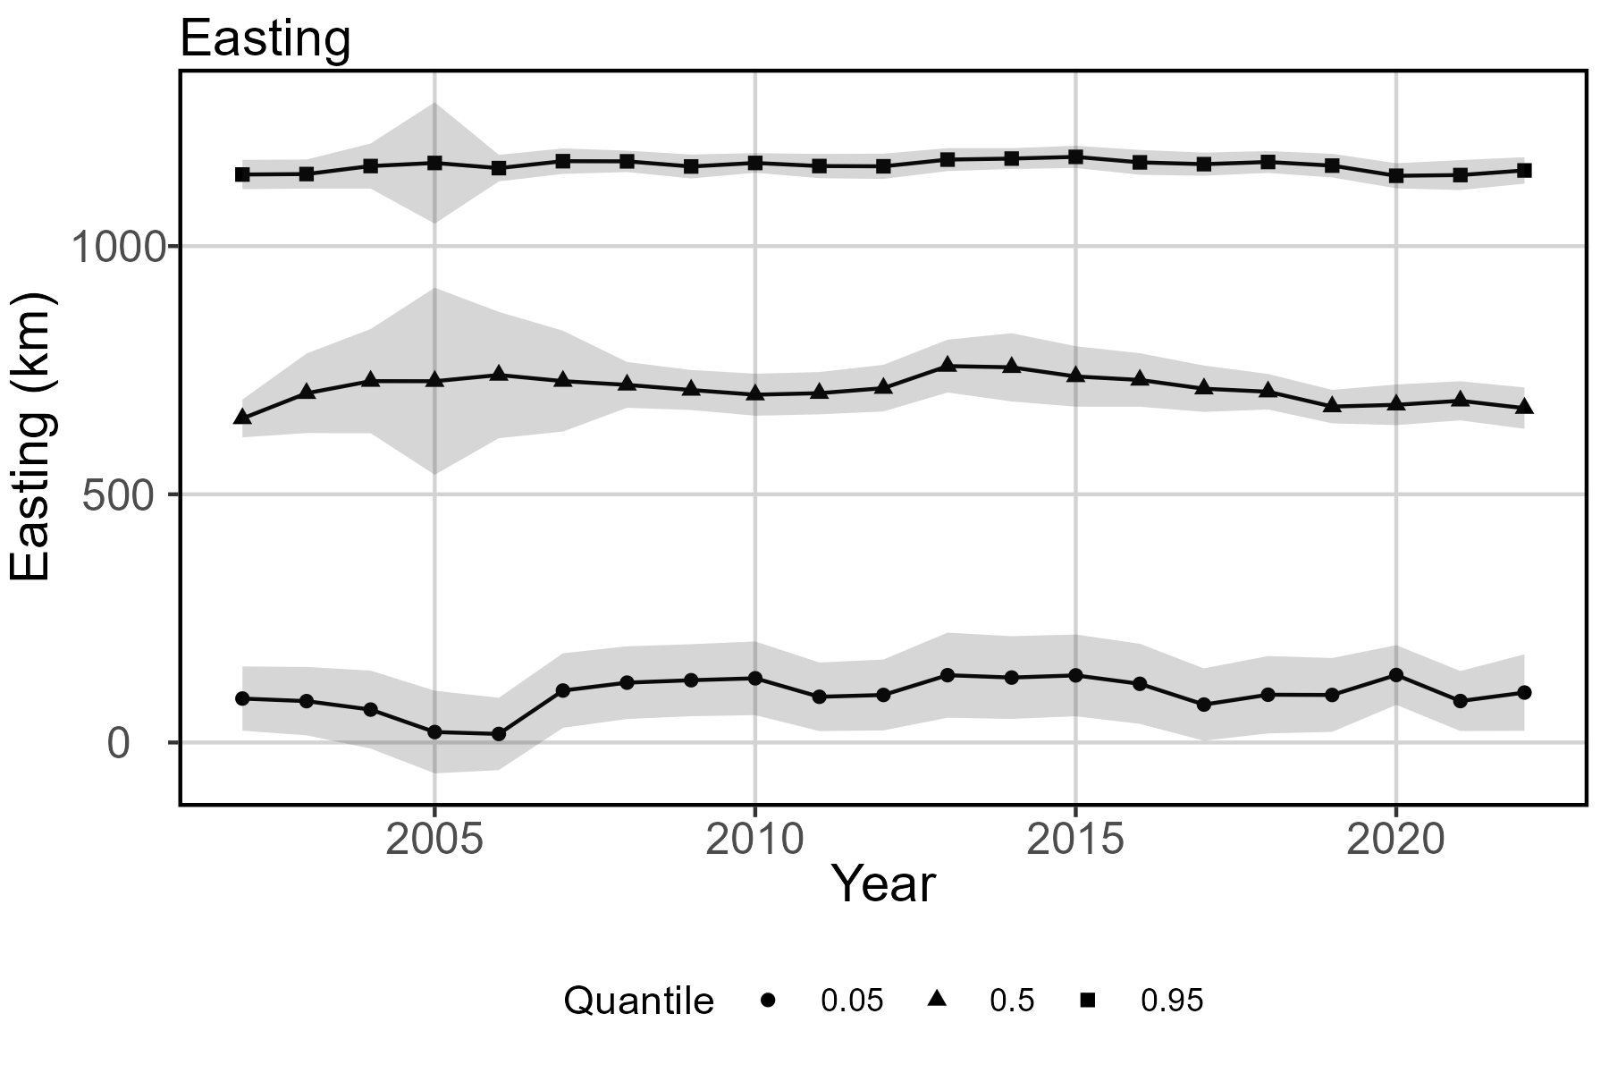
Range Edges

Slide 54
Relative abundance index takeaways
Range edges not addressed in previous models
Ecological meaning
0.05 quantile shifts north (2.9 km/ yr) and east (2.0 km/ yr).
0.5 quantile shifts SOUTH (0.9 km/yr ) and WEST (0.9 km/yr)
0.95 quantile is not super informative given artificial break conforming to spatial range of data provided by DFO. Tons more tuna in GSL not accounted for. But here, shows negligible change.
Overall: slight compression at south edge, while center of gravity and 0.5 quantile show shifts inshore and south.

Slide 55
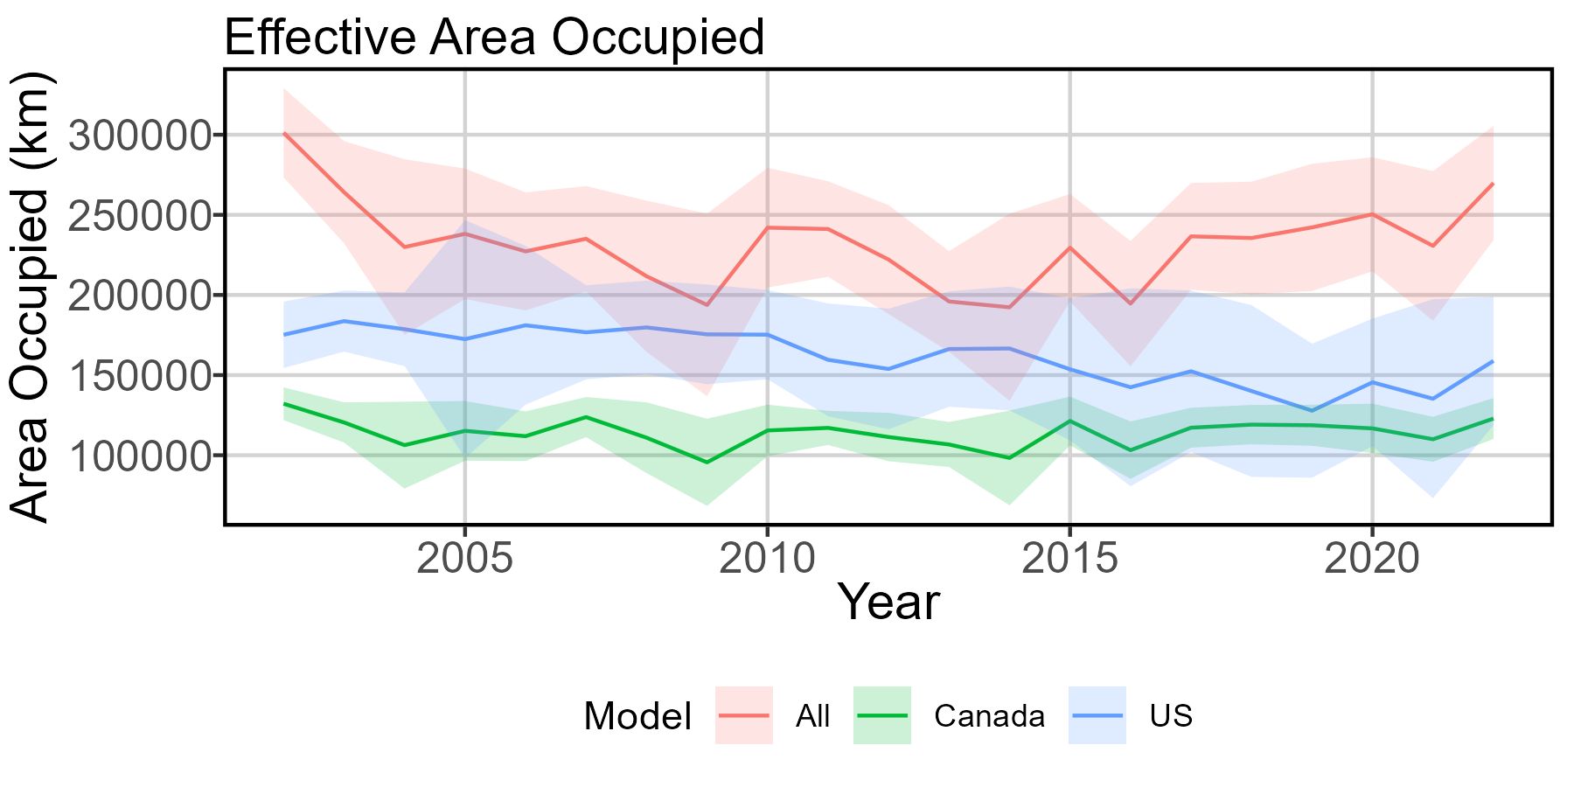
Effective area occupied - strata
Notes:
US stratum 59% of joint area, Canadian stratum 41%.

Slide 56
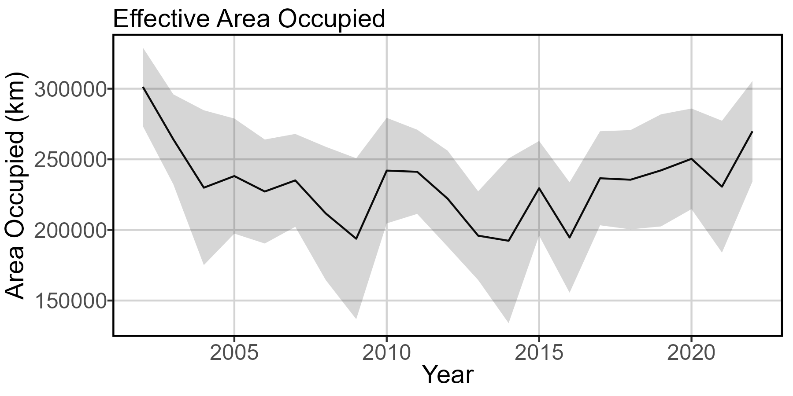
Effective area occupied
Notes:
General decline until about 2014, general increase since.

Slide 57
Effective area occupied takeaways
Not addressed in previous model
Ecological meaning
Overall decrease in area occupied (average loss 612 sqkm/ yr)
Loss of habitat more pronounced in US stratum. Relatively stable in Canadian stratum.
Makes sense given northward creep of southern range end
Have seen some recovery since 2014, but we have not yet returned to area occupied estimated for 2002.

Slide 58
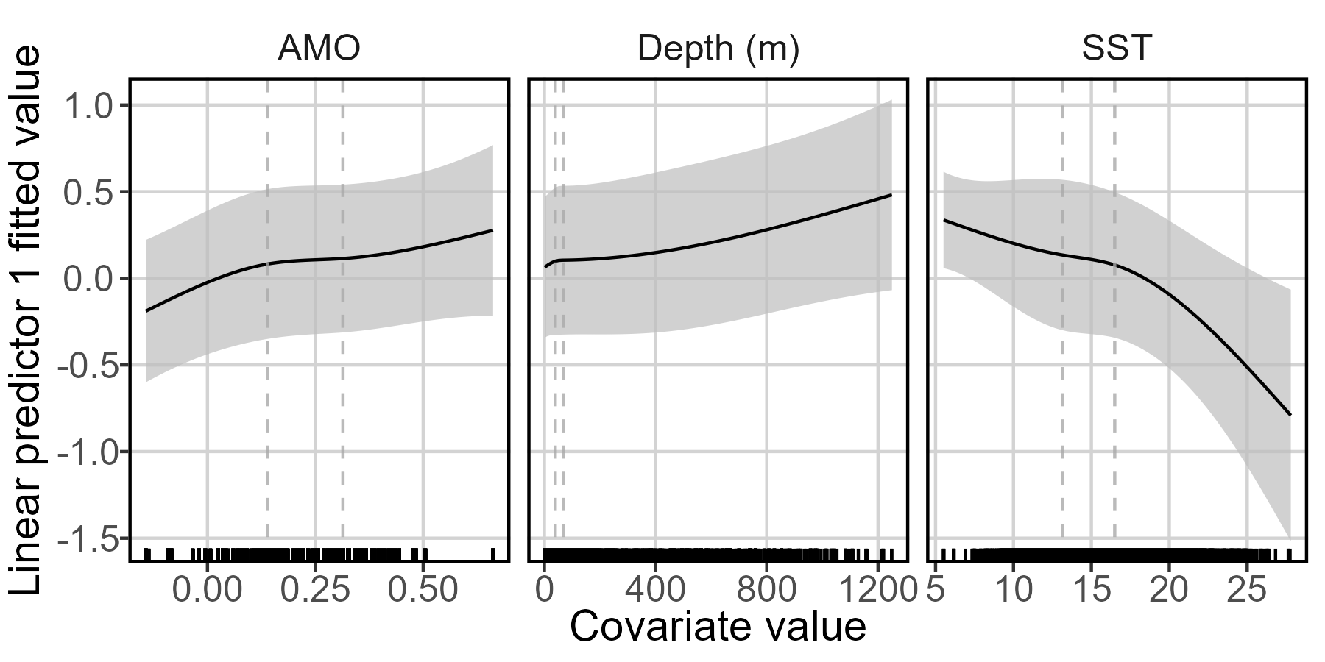
Density Covariate Marginal Effects – Presence/Absence
Notes:
Dashed vertical lines are where internal knots are placed (0.33, 0.66 quantiles).

Slide 59
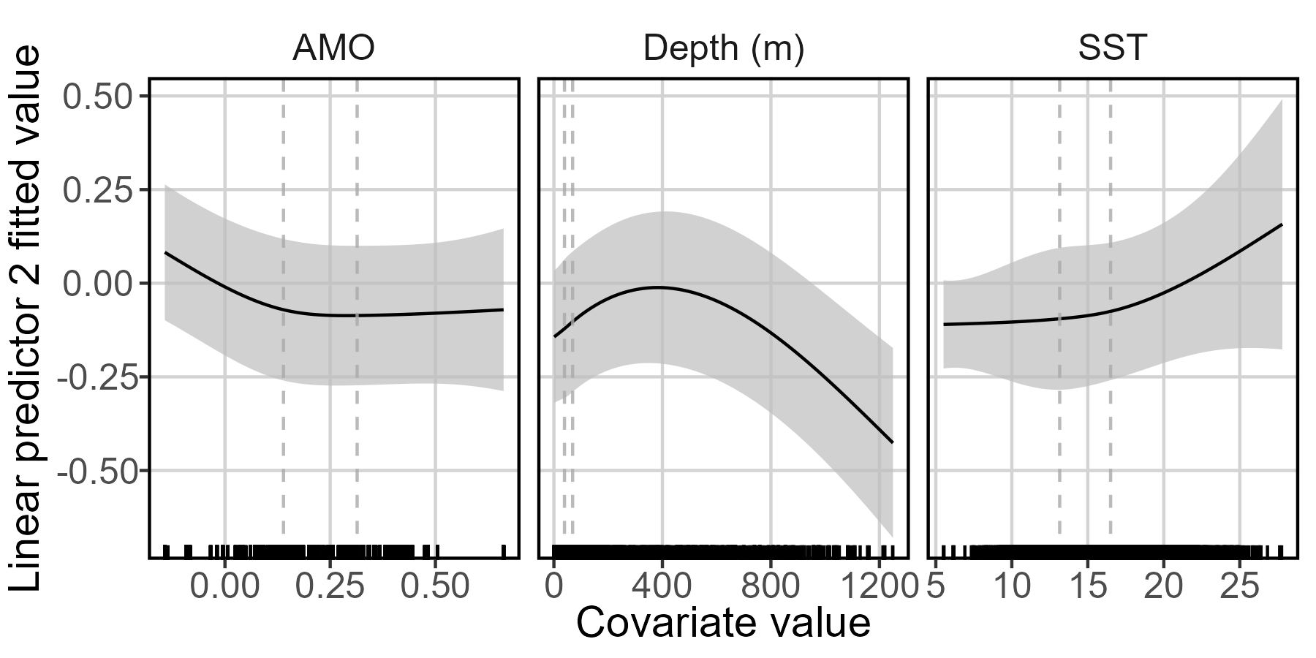
Density Covariate Marginal Effects – Positive catch rate
Notes:
Dashed vertical lines are where internal knots are placed (0.33, 0.66 quantiles).

Slide 60
Density covariate marginal effects takeaways
Marginal effects not assessed in previous model (new feature)
Ecological meaning
High SST translates to low probability of encounter, but weirdly also high positive catch rate. So, they probably won’t be around, but if they are you’ll see a lot of them.
AMO has a little more of an effect here than the US only model, with increasing strength of positive phase increasing encounter. No real effect on positive catch rate.
Depth is difficult to assess. Majority of the data are in waters less than 200m deep. There are many outliers up to 1200m. Relationship indicates increased presence with depth, but declining positive catch after around 400m.

Slide 61
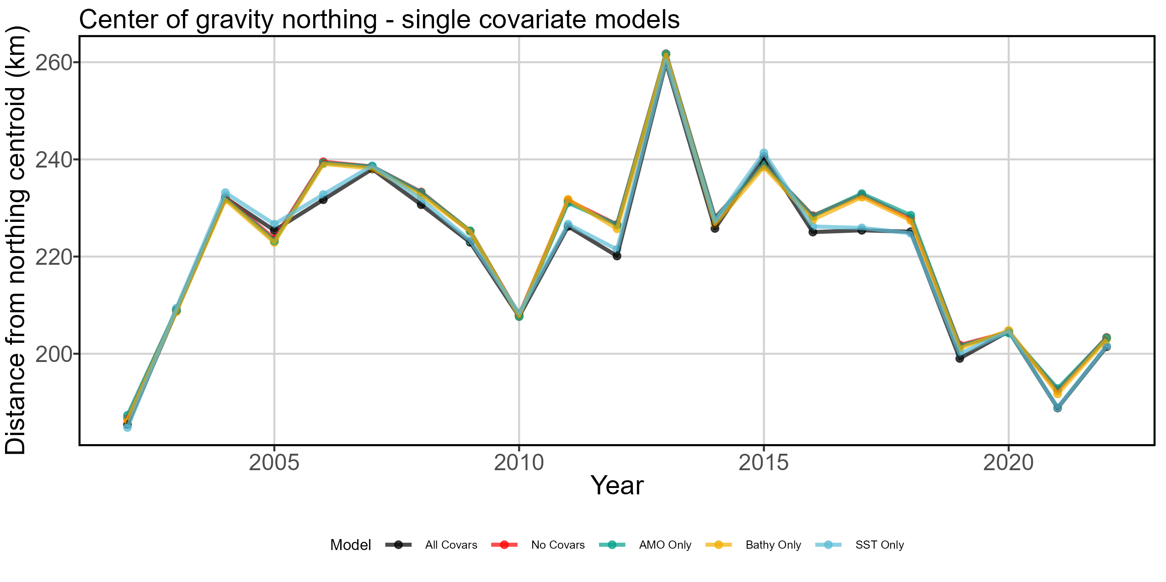
Relative explanatory power of density covariates

Slide 62
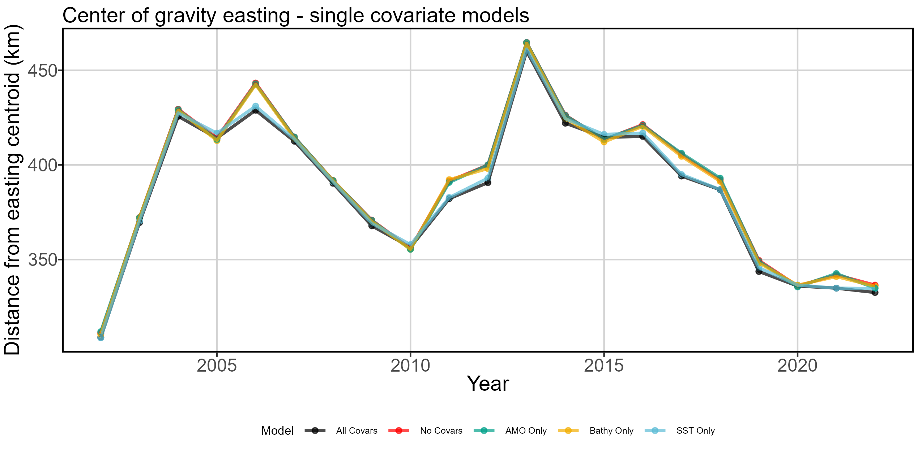
Relative explanatory power of density covariates

Slide 63
Relative explanatory power of covariates takeaways
Model comparison
Previous model only discusses covariate selection through lens of model selection via AIC. Ends up dropping all but SST.
Ecological meaning
Honestly all pretty close together
SST only model residuals have lowest sum of squared errors, indicating it is the closest to the model with all covariates.
AMO only model worse than the no covariate model at matching northing trends (not for easting though)
Notes:
Again, consider the problem with AMO: 2002-2022 are all positive phase years of varying strength. We have no negative phase years as a comparison. We have slightly less positive AMO phases in November and December of most years, which is entirely driven by Canadian data.

Slide 64
Overall
Comparison
Old and new models hard to compare because little spatial output for old model.
Abundance
But again, they show similar indices of abundance.
Center of gravity
Noticeable northward shift 2002-2013, slow return to early 2000s center of gravity area.
Average annual center of gravity change is slight southwestward shift
Range shifts
Range edges and effective area occupied show habitat compression at southern edge.
Density covariates
Major driver is SST.
Canadian effort has shifted dramatically later into the year, which means average yearly SST encountered in the fishery hasn’t changed as much as seen in the more temporally-consistent American effort. But temperature in effort-heavy months (Sep-Nov) have increased.

Slide 65
Tweaks
I’m open to suggestions on perhaps adding month as a catchability covariate or some other structure that accounts for the population shift South-North from June-December.
Other than that, not much else to accomplish on this one.
Turn on bias correction and yeehaw, let her rip

Slide 66
Ending thoughts
I think we’re at a stopping point. Last step is to turn on bias correction and let her rip on the HPC.
Comparing the old and new models is a bit like apples and oranges. Too many changes in sample data inputs, covariate data inputs, model structure, model domains.
That being said, joint indices look reasonable and tell a similar story to the old models– increasing joint abundance in the western Atlantic since 2014.

Slide 67
BONUS SECTIONS Probably too much detail for anyone but me. Lots of background info and justifications.

Slide 68
Joint model structuring and input decisions

Slide 69
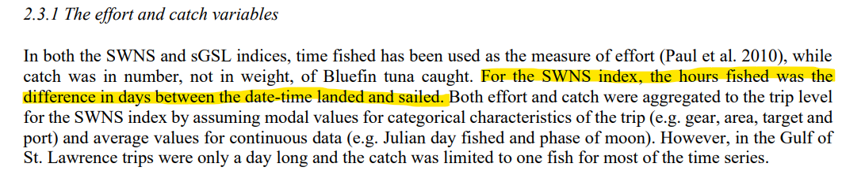
Merging Canadian and US effort measures
US models use fisher-reported time spent fishing as effort
Previous Canadian models used total time at sea as effort
Cannot mix units here; leads to “wash-out” effect on Canadian indices
Hanke (2021): Updated indicators of relative abundance for bluefin tuna based on revised treatments of the Canadian fisheries data
Notes:
At-sea time was taken as-is in this model. Which, we have learned from Sosthene, includes many nonsense values.

Slide 70
Merging Canadian and US effort measures
Backtracked through original Canadian dataset and found fisher-provided measures of hours spent fishing
Issue: not every logbook report includes a valid fishing hours variable, many instances of 0 hours fishing reported with valid measurements of time at sea. So how did you catch any fish then, if you trotted out there and spent no time fishing?
Issue: Sosthene used hierarchical clustering to fix issues with reported time at sea, but did not adjust hours spent fishing (it isn’t his effort measure). I will have to fix this.
There are 3014 instances where time fishing is not reported. In another 2118 instances, fishing time is greater than or equal to reported time spent at sea. There are nearly 20,000 records in total.

Slide 71
Merging Canadian and US effort measures
Solution: modeled proportion of hours fishing to time at sea
Clustered by fleet, NAFO fishing subunit, port landed, year, and month.
If cluster had 4 or more reasonable reports of time spent fishing given time spent at sea (time fishing is less than time spent at sea), used kernel density estimation to calculate most probable proportion of time spent fishing to time spent at sea.
Then repeated the process dropping the month label. Finally, repeated the process dropping the year label. Idea is to keep clusters as similar as possible. Fixed 1183 values in the most precise cluster, another 412 after dropping the month label, and another 418 after dropping the year label.
Only had to remove 105 samples out of nearly 20,000- uncommon or unique combinations of fleet, fishing area, and port landed.

Slide 72
Deciding on spatial domains and model structure for both joint and prey models

Slide 73
Spatial domain and fleets
Massive differences in US rec tuna, US comm prey, Canadian comm tuna fleet behaviors
Using Flag/Gear combo as a vessel effect for tuna models, in which random variation in catchability varies by Flag/Gear grouping.
Previously was using all EEZ waters, but this includes massive offshore areas with no sampling attempts for any of our fish of interest.
Prey and Joint spatial domain will be bound to NAFO areas 6B-4W (South to North), coast to continental shelf + 10km (Inshore to Offshore).
Unable to run US only tuna model for entire US continental shelf. Will discuss later.
23 American and 156 Canadian tuna samples are excluded from the joint model as being too far from the continental shelf edge or outside NAFO areas.

Slide 74
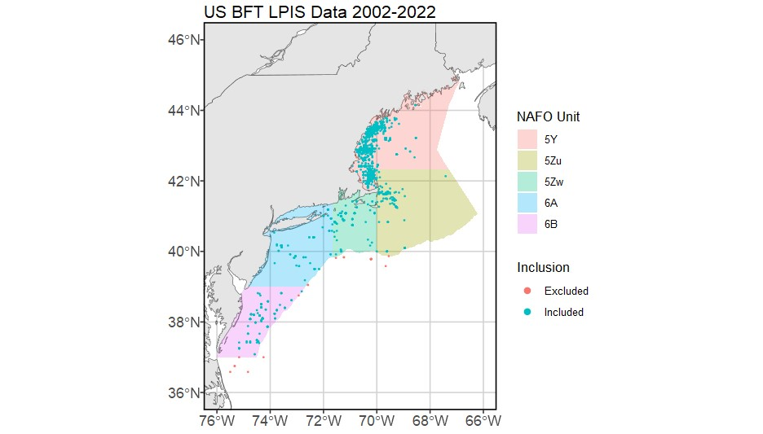
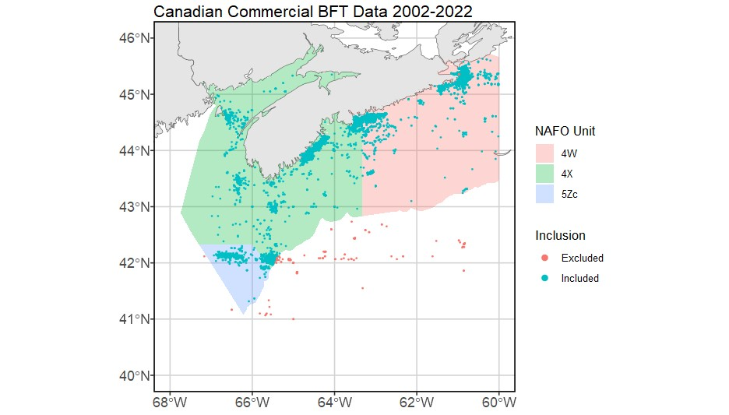
Joint spatial domain – Tuna
Notes:
- American recreational effort is closer to shore and typically bound to well-known fishing grounds defined by bathymetric features (canyons, banks, ledges, wrecks, etc)
- Canadian commercial effort is more widespread, but still concentrates in select inshore regions around major ports and offshore fishing grounds like Browns Bank.

Slide 75
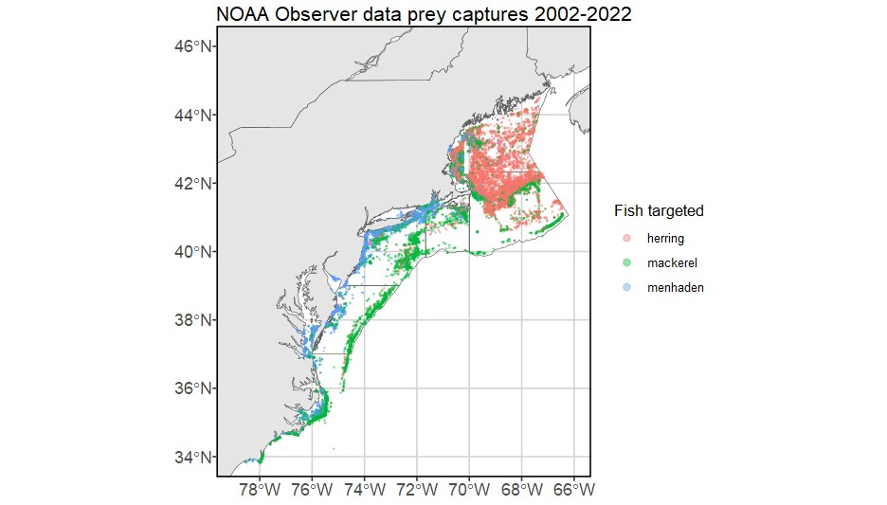
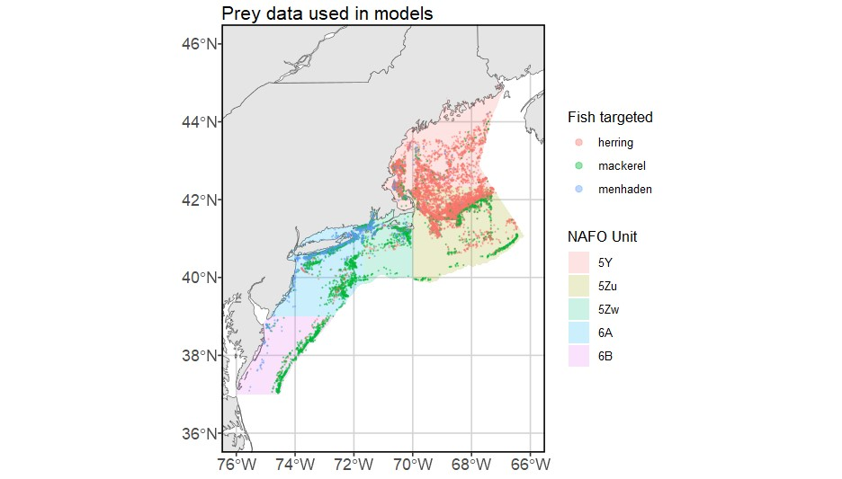
Spatial domain – Prey
Notes:
- Removed inshore estuary data and data from south of NAFO unit 6B
- Those weird bits in GoM/ GB that look like intentionally blank squares are closed areas in which trawling is not allowed.
- No inshore data north of Portland– does herring fishing happen up here? Are there just no observers to make a note of it? Not sure.

Slide 76
BFT Prey VAST model

Slide 77
Data input decisions
Prey spatial domain is US Continental Shelf + 10km (we lose maybe 5 samples that are more than 10km outside the continental shelf edge)
Full dataset includes many gear types and no measurements of effort
Without effort, was forced to choose one gear type. Went with otter trawls, as they are the most common gear across all three fishes. I know this is not likely data from directed fisheries– the forage fish are caught as bycatch. You’re not fishing smart if you’re looking for menhaden/ herring with a bottom trawl.
All samples assigned a unitless 1 effort value
Data can be modeled at monthly timestep and include category separations for herrings, mackerels, and menhaden. Later sum across fish types to get full prey field per month.
Each sampling event has a component for biomass of each prey group. Usually just one prey group is caught. This helps us add zeroes so the model has some contrast.
Notes:
Checked with Alex on the effort; it’s not recorded. He says there’s no easy way to come up with a measure of effort, either.

Slide 78
Model structuring decisions
Data availability does not support fine-scale spatial heterogeneity modeling, similar to the tuna models.
No density covariates! Just flat-out capture data.
Don’t want to introduce collinearity by using the same density covariates in this model, which will be later nested WITHIN the US-only tuna model anyway.
Spatio-temporal variation in the first linear predictor is a fixed random effect that follows an AR1 process
Variance is therefore estimated as fixed effects with a separate first-order autoregressive parameter for each category
These hyperparameters are copied to the second linear predictor. This makes sense, we must link presence/absence and abundance anyway because we have limited amount of data where fish were not captured.

Slide 79
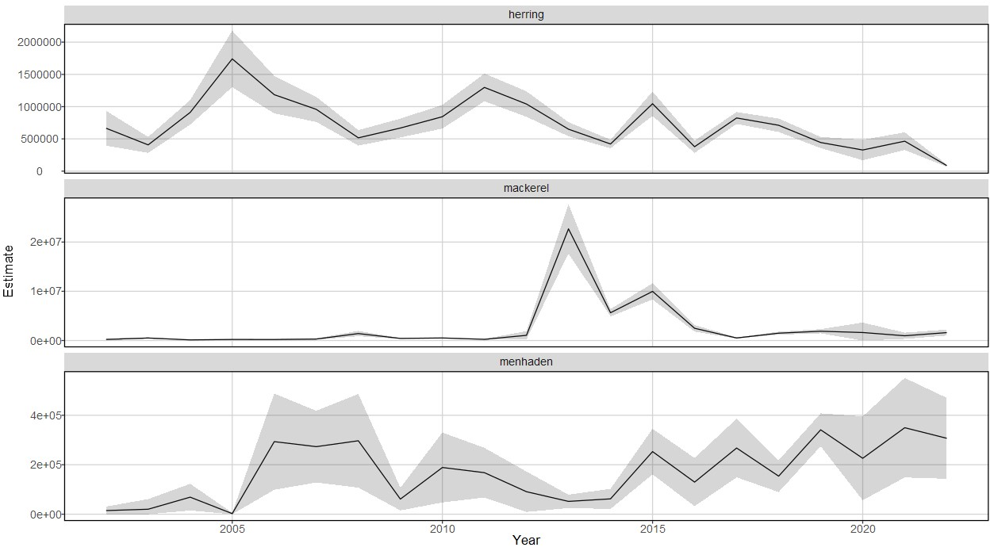
Annual relative indices of abundance
Notes:
Herring abundance decreasing with time. Lowest historical abundance (in model temporal domain) in 2022.
Mackerel have massive variation 2013-2015. Otherwise, relatively low abundance. I think targeting mackerel is opportunistic, or maybe they’re just common bycatch.
Menhaden abundance relatively low compared to herring throughout time series, but increasing since 2014.

Slide 80
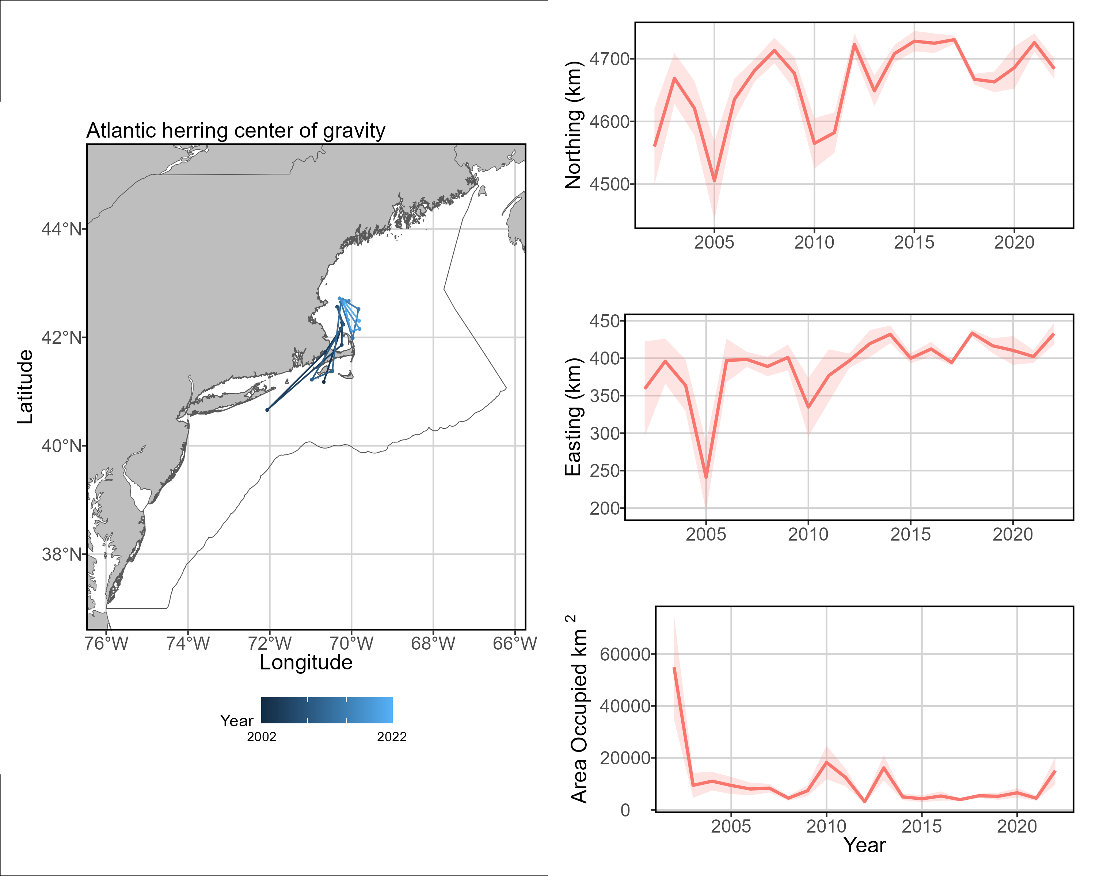
Distribution shifts
Notes:
Other than whatever weirdness happened in 2005 to pull the center of gravity down to the NYB area, this looks reasonable to me. Stock COG is mostly in the vicinity of Stellwagen Bank with possible 20-50km northward shift in 20 years.

Slide 81
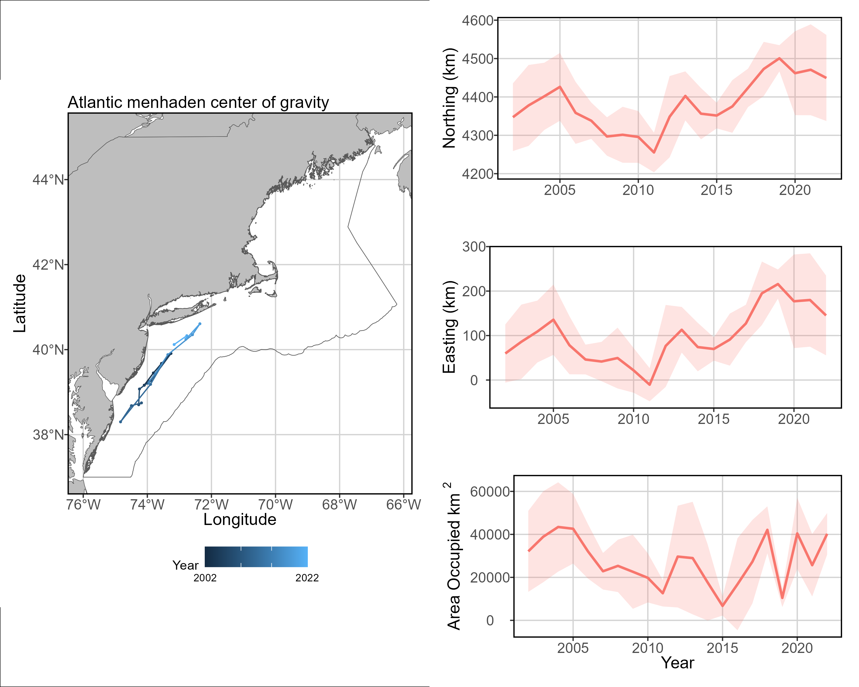
Distribution shifts
Notes:
This one’s pretty cool and matches what we know about declining recruitment from Chesapeake Bay and an otherwise healthy population. Examination of range edges (results not reproduced in this PPT) indicates that new or increased productivity in the north is expanding the range edge northward into the GOM and pulling the center of gravity with it. Also see incredible increase in productivity along south shore of Long Island since 2015. Anecdotal fisherman evidence that BFT catch along Long Island coast exploded in late 2010s (like, you could take a center console out of Rockaway Inlet and bring your tuna back into Brooklyn/Queens by nightfall). Thinking this is probably related.

Slide 82
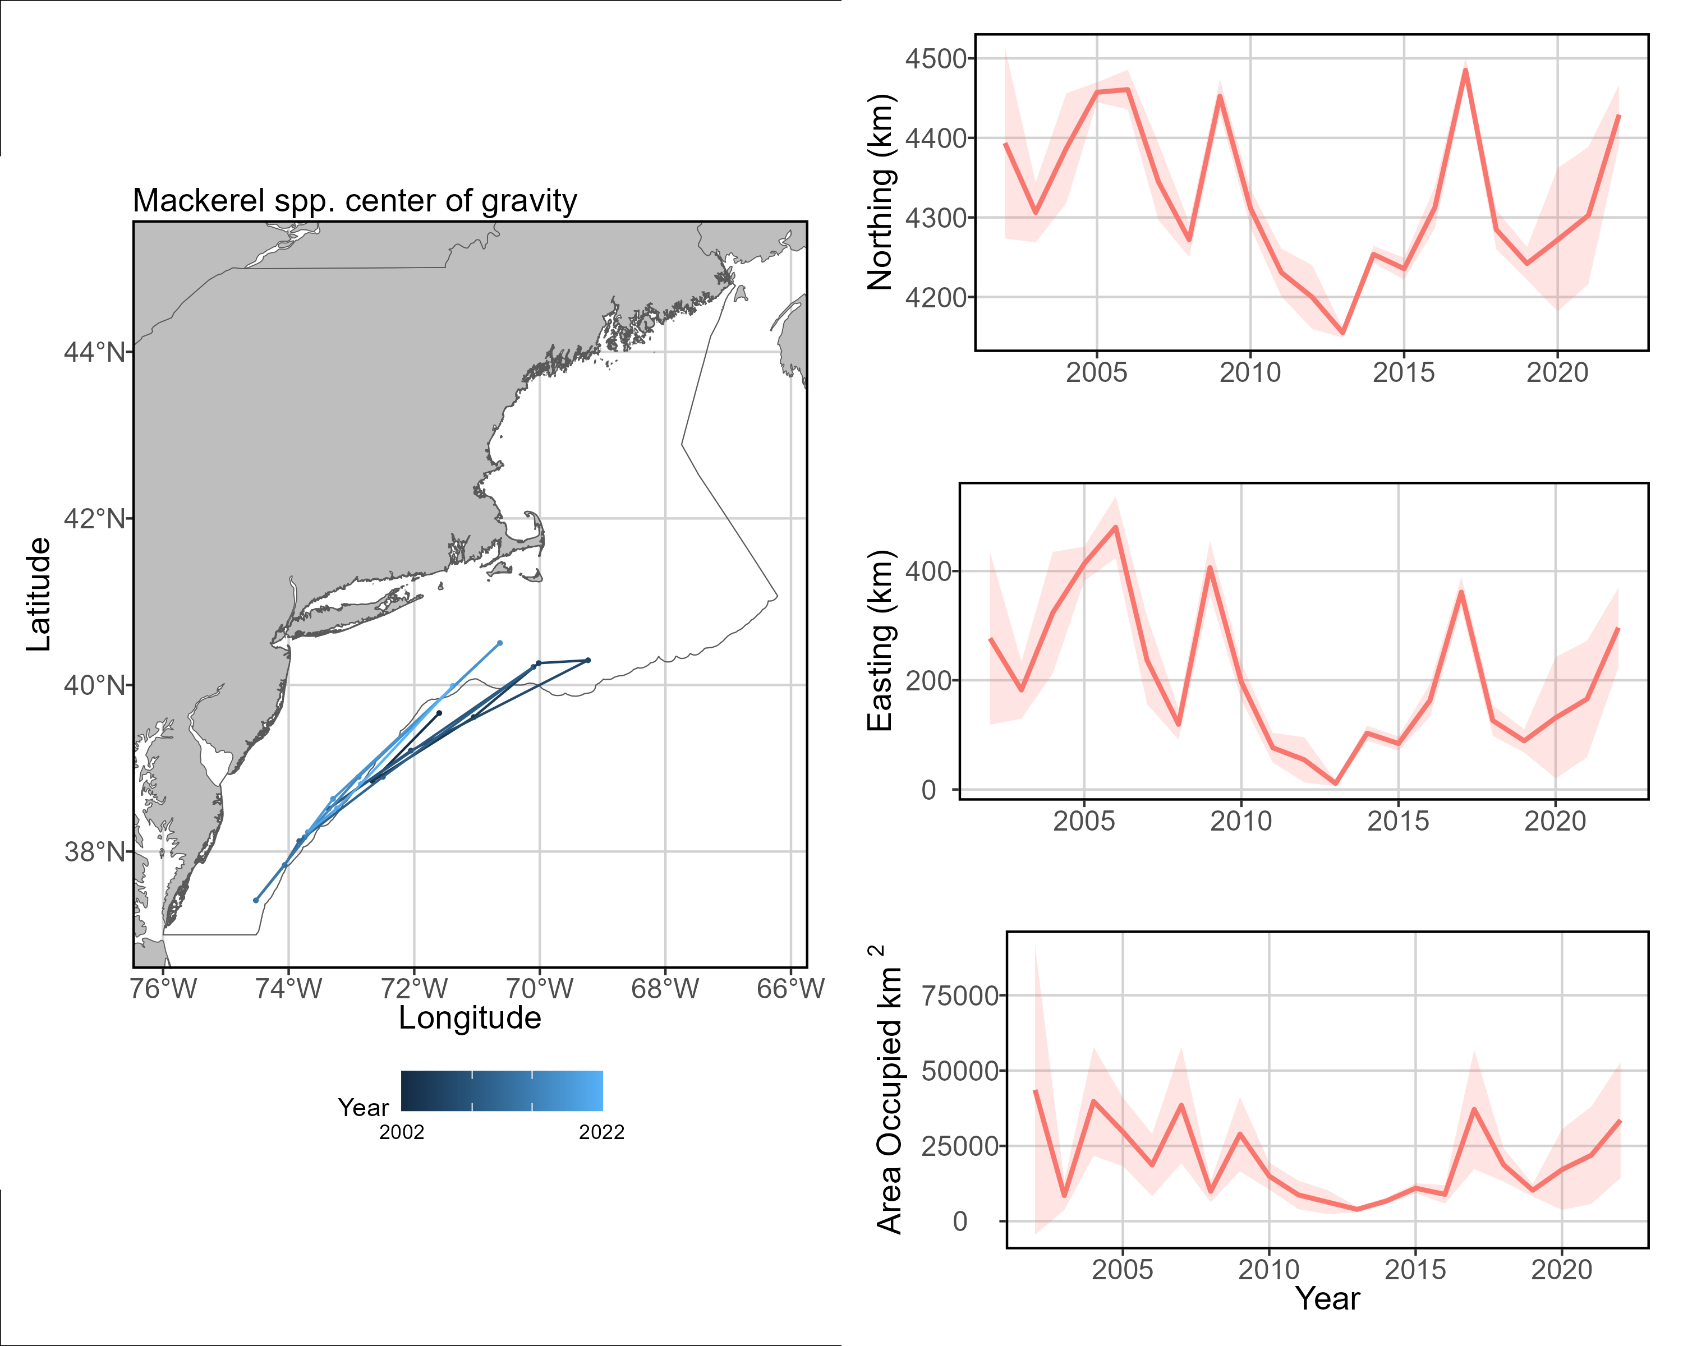
Distribution shifts
Notes:
Given the southern and offshore centers of gravity, I’m not sure how important mackerel are to BFT diets relative to herring and menhaden. OR, and more likely, we just don’t have enough data to make a stable model.

Slide 83
Considerations and improvements
No observer data from June or July 2020, means we have to discard tuna trips in this time because there is no prey field data. Consider predicting or estimating prey spatial density in those months.

Slide 84
Shifts in US Large BFT fishery spatio-temporal effort

Slide 85
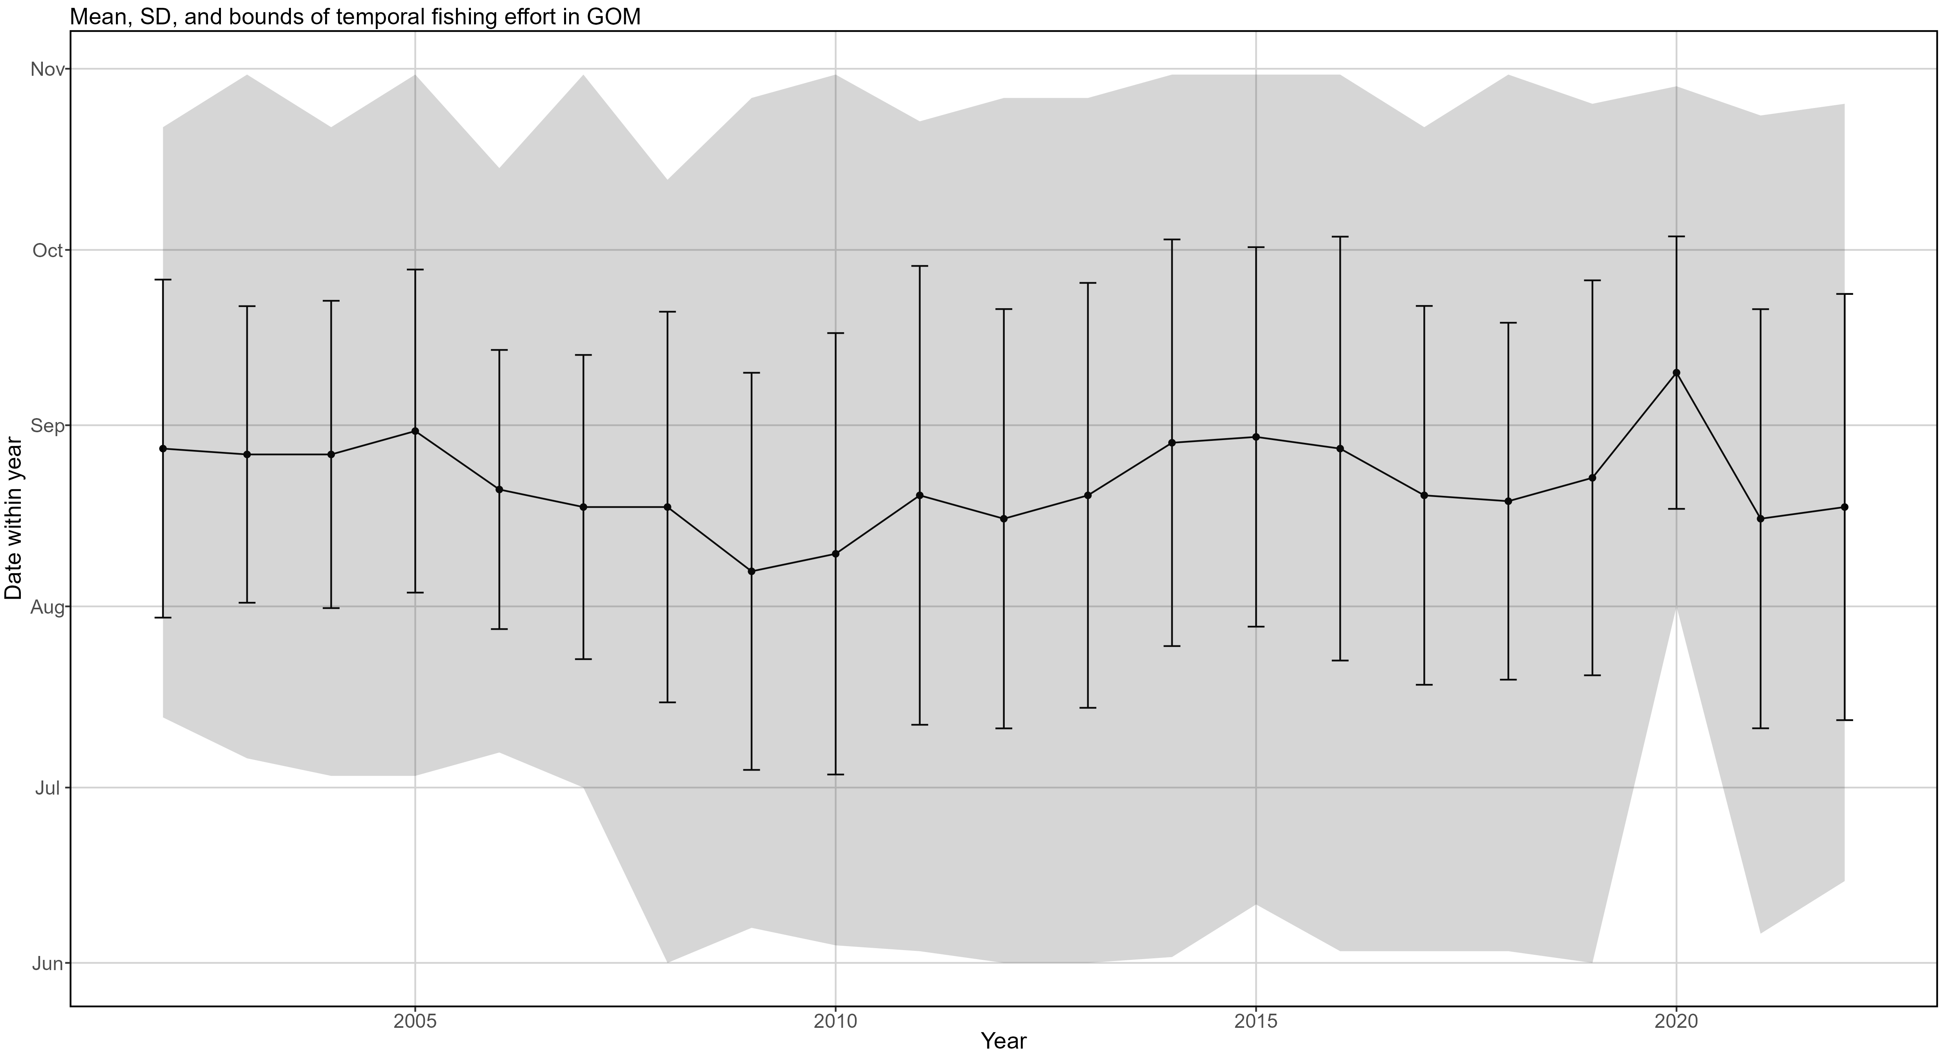
Temporal shifts in effort
Notes:
Error bars: +/- 1 SD. Point: mean date in year. Shaded region: min and max date for fishing events included in model.
Fishing in June did not begin until 2008.
2020 June-July trips artificially missing from modeling efforts (missing prey data from NOAA observers, had to exclude)
Fishing events mostly occur in August – mid-September.
Fishing effort condensed in earlier years of time series. 2010-present sees more effort over longer period.

Slide 86
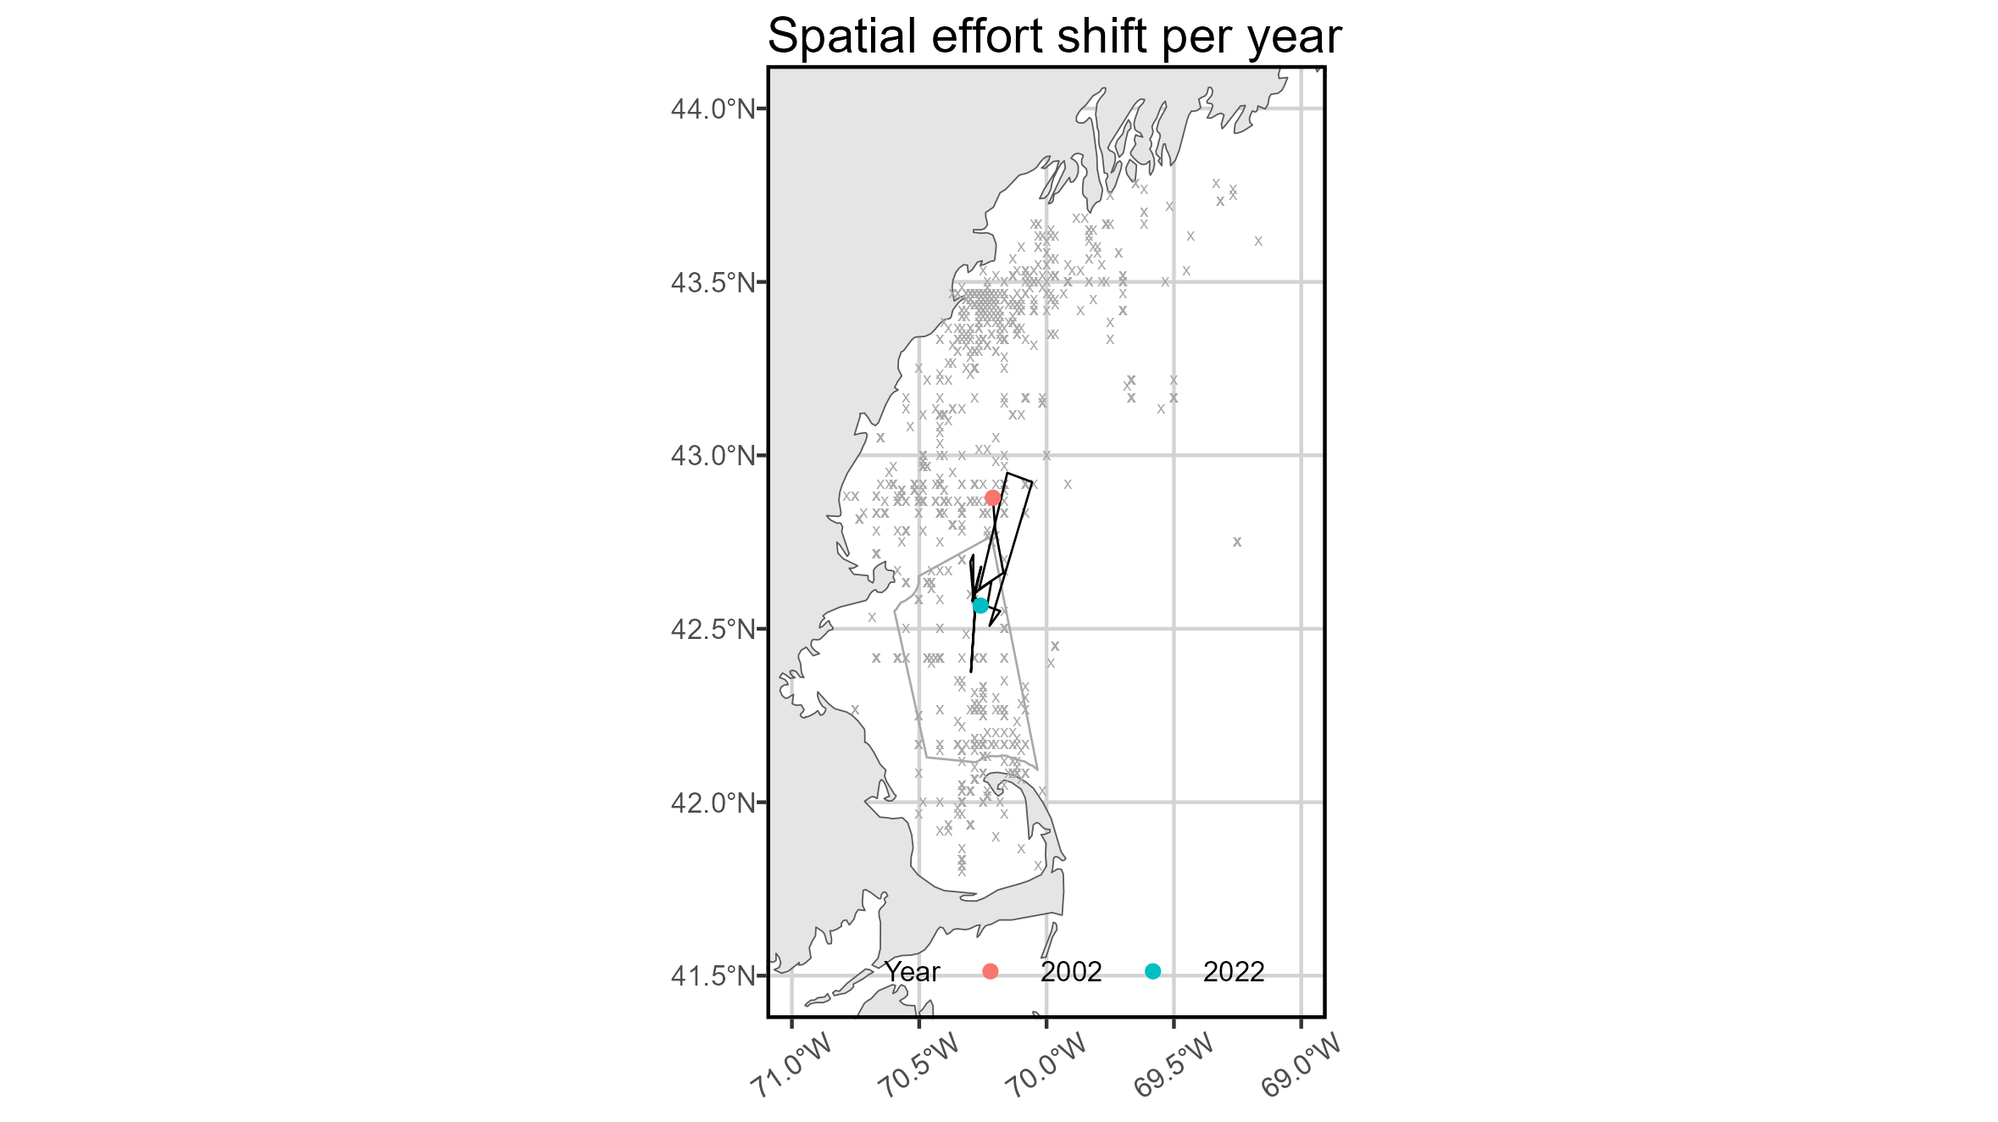

Annual and monthly shifts in effort
Notes:
Effort has shifted southwest over time series.
Interesting parabolic south-north-south monthly shift in effort.

Slide 87

Yearly shift in effort per month

Slide 88
Yearly shift in effort per month
Notes:
Effort has shifted north in shoulder months (June, October) and south in major months (July-September).

Slide 89
What does this mean for the modeling
Fishery-dependent data is hard to work with!
Spatio-temporal shifts in effort distribution and intensity have the potential to be “unseen hands” affecting time series of abundance, center of gravity, etc.
This is hard to account for in the US-only model, as most attempts to put any kind of temporal correlation structure on spatio-temporal effects caused the model to fail
As is, spatio-temporal variation for the first linear predictor is treated as a random effect with a random walk, rather than entirely independent between years. Hopefully this ameliorates the issue.

Slide 90
Shifts in Canadian “Large” BFT fishery spatio-temporal effort

Slide 91

Temporal shifts in effort
Notes:
Error bars: +/- 1 SD. Point: mean date in year. Shaded region: min and max date for fishing events included in model.
Very obvious shift in temporal effort, from concentrated in mid-September (early years) to concentrated in late-October (later years).
Earliest fishing data in 2020 end of August– not sure if this is representative of lockdowns affecting fishing OR just reporting.
Also expansion of temporal effort over years, min/max extend outward and period of concentrated effort takes place over longer time. SD shifts from 18 days to 28 days.

Slide 92


Annual and monthly shifts in effort
Notes:
Effort has shifted northeast along coast over time series, driven by increased effort in December at northern tip of NS.
Huge spatial range in monthly centers of gravity. August most south, December most north.

Slide 93

Yearly shift in effort per month
Notes:
July fishing sporadic, far more common in early time series. Usually determined by <15 events.
August and September only months to always have at least 1 observation in each year. Fishing activity in August peters out from >100 events 2002-2008 to <50 events 2011-2021. Pretty clear attempts to track pockets of known fish density as BFT migrate from US to CA waters.
September fishing slightly more consistent but also sees decline over time.

Slide 94
Yearly shift in effort per month
Notes:
October fishing really begins in 2005, COG near Grand Manan in 2002 driven by 3 events and should be considered spurious.
November fishing kicks off in 2004 with few events, gains popularity by 2007 and steadily increases in number of events per year.
December fishing has really tight spatial activity area with very few events not at that northern tip of NS. Center of gravity obviously very tight, too. Begins in 2015.

Slide 95
What does this mean for the modeling
The spatio-temporal changes in Canadian effort distribution and intensity are much more pronounced than the US changes
Thankfully, the joint model can support more sophisticated temporal correlation structures.
As is, the joint model treats spatio-temporal variation in each year as a random effect following an AR(1) process.

Slide 96
Failed US Only models and what I learned from them: Justifications for current modeling decisions

Slide 97
Difficulties
Majority of sampling in NAFO area 5Y (Gulf of Maine)
Just under 10k sampling events over entire US continental shelf. 8k of these are in the Gulf of Maine.
Efforts to run the US only model over various larger spatial domains fail. I tried all reasonable (spatially connected) combinations of NAFO areas and a few unique spatial domains that used a constant distance from shore as the outward edge.
End result: US only model with prey can only be run in Gulf of Maine, and even then results in EGOM are unreliable. I tried trimming this spatial extent to just west of -69°W, but this would not converge.

Slide 98


Difficulties
54980 sq km
65230 sq km
24488 sq km
43950 sq km
32917 sq km
Notes:
Every strata but the Gulf of Maine and Georges Bank (5Y and 5Zu) has too few trips over the 20-year time series to reasonably model spatial density. Trips are also clustered around bathymetric features and relatively close to shore, so most of the spatial area is never sampled.

Slide 99
Difficulties
Limited capture success
7950 samples in the Gulf of Maine with all necessary environmental and spatial information. 1480 instances of capture, only 77 of which were multiple fish.
This is not enough contrast to provide useful information to the second linear predictor, positive catch rate (abundance).
A few years have under 10 fish landed – 2004, 2006, 2013.
End result: drop spatial and spatio-temporal effects for the 2nd linear predictor
Model fails every time, with every reasonable structure, if spatial and spatio-temporal effects are left on for the 2nd linear predictor.

Slide 100

Difficulties
54980 sq km
65230 sq km
24488 sq km
43950 sq km
32917 sq km
Notes:
All strata but Gulf of Maine and Georges Bank (5Y and 5Zu) have too few fish caught per year to model presence/absence, let alone positive catch rate.
Georges Bank strata has long period (2006 – 2017) of low success, making it difficult to model positive catch rate.

Slide 101

Difficulties
54980 sq km
65230 sq km
24488 sq km
43950 sq km
32917 sq km
Notes:
All strata but Gulf of Maine have years with either no effort in the spatial domain OR no fish caught.
As a cool aside, you can see the “Wicked Tuna Effect” in full swing for the Gulf of Maine 2013-2014 (show aired in Fall 2012) and maybe a little bit of lagging effect of a marine heatwave in 2012 driving down success per trip.

Slide 102

Difficulties
Massive spatial and temporal gaps in sampling
Model must extrapolate encounter probability/ positive catch rates in space from further and further away sampling points
Gives incredibly bizarre results in the years where there are actually sampling points in the undersampled regions. See next slide.

Slide 103



Difficulties
Data
Encounter Prob.
Pos. Catch Rate
Notes:
The obvious spatial split in encounter probability/ positive catch rate is caused by the eastern half of the Gulf of Maine being predicted by one sample, which is indicated by the red circle. This causes large confidence intervals for most metrics pulled for this year– relative abundance, center of gravity, effective area used, etc. This is a problem in 2015 and 2017, and to a slightly lesser extent 2019.

Slide 104


Difficulties
I ran some models removing all “Eastern” Gulf of Maine samples (east of 69°W) but retaining full GOM spatial domain.
This converged, fixed the spatial split issue without changing abundance or spatial metrics much.
This was the best possible spatial domain and data input combination

Slide 105

Difficulties
I ran other models removing the spatial area and samples east of 69°W.
Model needed 150 knots to converge (tiny grid cells, very fine spatial scale).
Results indicate some kind of issue, likely overparameterization or poor fit to random-effect terms
Issues visually represented by “missing” grid cells in model outputs.

Slide 106



Difficulties
Model cannot fit to 2022 data
Model rockets metrics dramatically away from trends of previous 4 years, have huge CIs
Inclusion of 2023 data would be possibly help, but it’s not published yet.
Would recommend not using 2022 in model interpretation.
Encounter
Pos catch
Notes:
Why does 2022 not fit well? I’m not sure, but it’s probably due to close proximity of successful trips in space between Fippennies Ledge in the east and the northeast edge of Stellwagen NMS in the west (the bright yellow area in the pos catch plot).

